Slide 1




INFANT MEAL PATTERN
REQUIREMENTS
Institute of Child Nutrition
Telephone: (800) 321-3054
E-Mail: helpdesk@theicn.org
Website: https://theicn.org/icn-resources-a-z/infant-meal-pattern-requirements-trainings/
Notes:
SHOW SLIDE: Infant Meal Pattern Requirements Training
DO:
To begin this training, advance to the next slide.

Slide 2
Child Nutrition Programs: Meal Patterns Consistent with the 2020–2025 Dietary Guidelines for Americans
NEW Federal Rule (CACFP)
Implementation Date: July 1, 2024
  Dietary Accommodations: Institutions and facilities are encouraged to accommodate non-disability dietary preferences in CACFP meal planning and preparation.
Implementation Date: October 1, 2025
  Added Sugars Limits: Changes sugar limits for breakfast cereals and yogurt, shifting from total sugars to added sugars.
  Medical Statements: State licensed healthcare professionals and registered dietitians can write medical statements.
Notes:
Overview: The USDA’s Food and Nutrition Service (FNS) has published a final rule titled, Child Nutrition Programs: Meal Patterns Consistent With the 2020-2025 Dietary Guidelines for Americans. This rule marks a significant advancement in improving child nutrition programs based on scientific research and stakeholder input.
Purpose and Impact: The update reinforces USDA's commitment to nutrition security by aligning with the latest dietary guidelines. It follows a comprehensive review of the 2020–2025 Dietary Guidelines for Americans and incorporates lessons learned from prior rulemakings.
Audience: In addition to standards for schools, the rule introduces specific requirements for those operating the Child and Adult Care Food Program and the Summer Food Service Program.
Key Focus Areas: Added Sugars Limits and Meal Modifications
Beginning July 1, 2024: Meal Modifications will go into effect.
Regarding non-disability requests, the regulation clarifies that the USDA encourages institutions and facilities to accommodate participants’ non-disability dietary preferences when planning and preparing CACFP meals.
Beginning October 1, 2025, additional meal modifications and the Added Sugars limits will go into effect:
Changes sugar limits for breakfast cereals and yogurt from total sugars to added sugars. CACFP total sugars limits remain in place until Oct. 1, 2025, when the added sugars limits must be implemented. Breakfast Cereals: Must contain no more than 6 grams of added sugars per dry ounce. Yogurt: Must contain no more than 12 grams of added sugars per 6 ounces.
Clarifies that both state licensed healthcare professionals and registered dietitians may write medical statements to request meal modifications on behalf of participants with disabilities.

Slide 3

Child Nutrition Programs: Meal Patterns Consistent with the 2020–2025 Dietary Guidelines for Americans (cont.)
NEW Federal Rule (CACFP)
CACFP & SFSP Standards:
  www.bit.ly/49PeLMZ
Available Support: The ICN’s Help Desk:
  Email: helpdesk@theicn.org
  Phone: 1-800-321-3054
Notes:
It’s important to note that other technical changes are included in the final rule, but they do not require modifications to menus or operations.
Please scan this QR code or use the link to the CACFP and SFSP standards to learn more about the latest standards.
Most importantly, the Institute of Child Nutrition is committed to your success with these new standards. If you have any questions, please feel free to contact our help desk for assistance or your State agency.

Slide 4

“Welcome to the
INFANT MEAL PATTERN
REQUIREMENTS Training!”
Notes:
SHOW SLIDE: Welcome
SAY:
Welcome to the Infant Meal Pattern Requirements training. First, the Institute of Child Nutrition would like to thank you for providing us with the opportunity to offer this CACFP Meal Pattern Requirements Supplemental training. It is our hope that you will gain the knowledge and skills for implementing the latest changes featured in the updated Child and Adult Care Food Program (CACFP) meal patterns regulations.
NOTE TO INSTRUCTOR: If this training is not sponsored by the Institute of Child Nutrition, provide information regarding the hosting organization.
DO:
Introduce yourself and other special guests. Be sure to state your name, title/credentials, and your experience in child care, CACFP, and other child nutrition programs. Confirm participants have printed and signed their names on the sign-in sheet(s), and they have all necessary materials for this training (i.e. Participant’s Workbook, pens or pencils, and activity supplies).

Slide 5

Activity: Define Training Success
Notes:
SHOW SLIDE: Activity: Define Training Success
DO:(Activity): Define Training Success
Purpose: The purpose of this activity is to help participants identify their expectations for this training, and it will help the trainer to identify ways to meet the needs of each participant.
Materials Needed: Flip chart(s) and markers
Time: 10 minutes
Instructions:
SAY: Let’s begin this training by getting to know each other a little better.
DO: Divide the class into groups of 3–5 participants, and distribute a flip chart and a marker(s) to each group. Ask participants to take their things with them, as they will remain in these groups throughout the remaining of the training.
SAY: Think about the benefits of attending this training and your overall expectations for what you would like to learn today. Then, introduce yourself and state one or two key points to complete the sentence: “This training will be a success for me, if____.” For example, this training will be a success for me, if everyone learns how to implement the updated infant meal pattern requirements. After everyone has shared within your group, use your flip chart to create a list of each of your responses.
DO: Allow participants 5 minutes to complete this activity. Then, request that each group share their responses with the large group and post their flip charts in the training area.
SAY: This activity allows you to set clear expectations for what you would like to learn today. Additionally, it allows me to understand your needs so that I may help ensure that you leave feeling confident about implementing the updated meal pattern requirements.
NOTE TO INSTRUCTOR: If this is a large group, divide the participants into groups of 6–8 participants.

Slide 6

Logistics
Ground rules
Breaks
Restroom location
“Bike Rack” for questions
Notes:
SHOW SLIDE: Logistics
SAY:
Now that we know more about each other, it is important that we create an environment that allows everyone to participate without fear of criticism while working together to accomplish the training’s objectives. To accomplish this goal, let’s review some housekeeping items and ground rules for today’s training.
The ground rules are posted (state location) and featured in your Participant’s Workbook. Please take a moment to review them.
We will take a minimum of two breaks during this training. Of course, if you need to stretch or attend to a need at a different time, please do so. Please be sure to return on time, as starting and ending breaks on time will allow us to cover all the training information and activities within the time allotted.
The restrooms are located (state location).
Last, I have posted a flip chart with the title “Bike Rack” (the former parking lot concept) (state location). Feel free to write any questions on a sticky note and post it to the “Bike Rack.” I will aim to answer all questions and share the information with the class before the end of this training. Although I will try to answer questions throughout the training, some questions may require research or a longer answer than time allows. Any questions I cannot answer, I will forward them to the ICN for further assistance.

Slide 7

CACFP in the Last 50 Years
Source for nutritious meals & snacks
  Infants, children, & adults
Shift in nutritional needs and eating habits
Notes:
SHOW SLIDE: CACFP in the Last 50 Years
SAY:
Since 1968, the CACFP has helped to ensure participants receive nutritious meals and snacks while attending child care and later adult care. Over the years, however, the nutritional needs and the eating habits of children and adults have shifted from those when the program first begin.
In particular, the overall health status of this country has shifted from deficiencies in essential nutrients, such as a lack of vitamins A and C, to chronic diseases, such as hypertension, heart disease, type 2 diabetes, and even some forms of cancer.

Slide 8

Purpose of the Update
Align with the national standards
Enhance the overall nutritional quality of meals and snacks
Notes:
SHOW SLIDE: Purpose of the Update
SAY:
In 2010, Congress called for the USDA Food and Nutrition Services (USDA FNS) to review and revise the CACFP meal pattern requirements to address the current health status of children and adults and to better align with the Dietary Guidelines for Americans (DGA). Understanding the DGA do not provide recommendations for infants, they used the scientific recommendations from the National Academy of Medicine, the American Academy of Pediatrics, and stakeholder input to update the infant meal pattern.
In April 2016, they released updated guidelines in the “CACFP: Meal Pattern Revisions Related to the Healthy, Hunger-Free Kids Act of 2010 Final Rule.”. In April 2024, the USDA FNS published the final rule titled, “Child Nutrition Programs: Meal Patterns Consistent With the 2020–2025 Dietary Guidelines for Americans,” which is the next step in continuing the science-based improvement of CACFP meals, as well as advancing USDA’s commitment to nutrition security. Ultimately, the updated meal pattern requirements are expected to enhance the overall nutritional quality of meals and snacks served in CACFP settings.

Slide 9

Infant Meal Pattern Requirements Overview
Meals are reimbursable when a mother breastfeeds on-site
Features two age groups: Birth–5 months & 6–11 months
Provides more nutritious meals and snacks
Notes:
SHOW SLIDE: Infant Meal Pattern Requirements Overview
SAY:
There are three major updates in the infant meal pattern.
First, they encourage and support breastfeeding by providing reimbursement when mothers breastfeed on-site.
Second, they promote developmentally appropriate meals by separating the infant age groups into two age groups instead of three.
Third, they provide meals that are more nutritious to promote the development of healthy eating habits, by:
requiring vegetables and fruits be served at snack;
disallowing juice, cheese food, and cheese spreads as creditable items; and
allowing yogurt, soy yogurt, tofu, and whole eggs to credit as meat alternates.
NOTE TO INSTRUCTOR: This slide provides an overview of the content in the training. If there are questions regarding the information, explain that you will provide additional information on each of the requirements throughout this training.

Slide 10

Overview
Connect the previous with the updated requirements
Highlight previously implemented policies
Explore policies effective October 1, 2017
Notes:
SHOW SLIDE: Overview
SAY:
Another great point worth mentioning is many of the updates expands on many of the requirements implemented in the past, and this may make it easier to connect those previously implemented with the updated requirements. Therefore, in today’s training, we will highlight some of the previously implemented policies to show the connection between the two, but spend the majority of our time exploring those requirements that went into effect October 1, 2017.

Slide 11
Objectives
Recall at least four changes to the updated infant meal pattern charts
Summarize at least two requirements for serving breast milk and infant formula
State three strategies that support infants’ developmental readiness for solid foods
Identify at least four new requirements for serving more nutritious solid foods
Notes:
SHOW SLIDE: Objectives
SAY:
In particular, we will cover the updated meal pattern requirements for infants and some strategies for implementation. At the end of this training, you should be able to:
recall at least four changes to the updated infant meal pattern charts,
summarize at least two requirements for serving breastmilk and infant formula based on the updated meal pattern,
state three strategies that support infants and their developmental readiness for solid foods, and
identify at least four new requirements for serving more nutritious solid foods to infants.
For your reference, you can find a list of the updated requirements on the Summaries of the Updated Meal Standards: Infant and the Infant Meal Pattern handouts in the Participant’s Workbook.
NOTE TO INSTRUCTOR: The aforementioned handouts are located on the following pages.

Slide 12

Pre-Assessment
Notes:
SHOW SLIDE: Pre-Assessment
DO:Pre-Assessment
Purpose: The purpose of this Pre-Assessment is to determine current knowledge of the updated meal pattern requirements.
Materials Needed: Pre-Assessment and pen or pencil
Time: 10 minutes
Instructions:
SAY: Before we begin objective 1, let’s assess what you already know about the updated meal pattern requirements by completing a Pre-Assessment.
DO: Distribute the Pre-Assessment.
SAY: Now that you have the Pre-Assessment, begin by placing an easy to remember, unique, non-name identifier, such as a word, phrase, or symbol, at the top of each page. Then, read each question carefully and select the best answer. Make a note of your non-name identifier as you will use it again when completing the Post-Assessment.
DO: Allow a minimum of 10 minutes for participants to complete the Pre-Assessment. Remind them to list a non-identifier and to make a note of it for the Post-Assessment. Then, collect each assessment and set them aside.
NOTE TO INSTRUCTOR: If the Institute of Child Nutrition (ICN) provides this training, collect the Pre-Assessments and return them along with the evaluations to ICN.
ASK:
Are there any questions before we begin exploring the first objective?
DO:
Answer any questions and then, move to the next slide.
NOTE TO INSTRUCTOR: If there are questions that you are unable to answer, refer the participant(s) to their State agency or to the ICN Help Desk.

Slide 13

Infant Meal Pattern
Previous vs. Updated Infant Meal Pattern Requirements
Notes:
OBJECTIVE 1: Participants will be able to recall at least four changes to the updated infant meal pattern charts.
SHOW SLIDE: Infant Meal Pattern
SAY:
Let’s begin by exploring the meal pattern charts. Turn to the Previous vs. Updated Infant Meal Pattern Requirements handout in your Participant’s Workbook. Take a minute to review the previous and the updated meal patterns to identify the changes on the charts.
DO:
Allow 3–5 minutes for participants to review the charts.
ASK:
What are some of the changes to the meal pattern? Are there very many changes?
DO:
Allow participants to respond and then, advance to the next slide.
FEEDBACK: Some potential responses may consist of the following statements:
Change in age groups
Breastmilk is the only required meal component for the first six months
Age groups begin with zero for all meal components, with the exception of breastmilk and infant formula

Slide 14

Changes in Age Groups
Previous Age Groups
Birth–3 months
4–7 months
8–11 months
Updated Age Groups
Birth–5 months
6–11 months
Notes:
SHOW SLIDE: Change in Age Groups
SAY:
[As you just mentioned,] there are a few key changes to the infant meal pattern. Let’s review some of those changes.
First, the previous meal pattern featured three age groups: Birth through 3 months, 4 through 6 months, and 7 through 12 months. However, now there are only two:
Birth through the end of 5 months
6 months through the end of 11 months

Slide 15

Question: What are some advantages to
having two age groups?
Notes:
SHOW SLIDE: Question—Two Age Groups
ASK:
When you think about the two age groups, what are some advantages of having two groups?
DO:
Allow participants to respond and then, advance to the next slide.
FEEDBACK: Some potential responses might include the following statements:
Consistent with the American Academy of Pediatrics (AAP) recommendations
Aligns with the Women, Infants, and Children (WIC) program
More simplistic because it is two groups instead of three

Slide 16
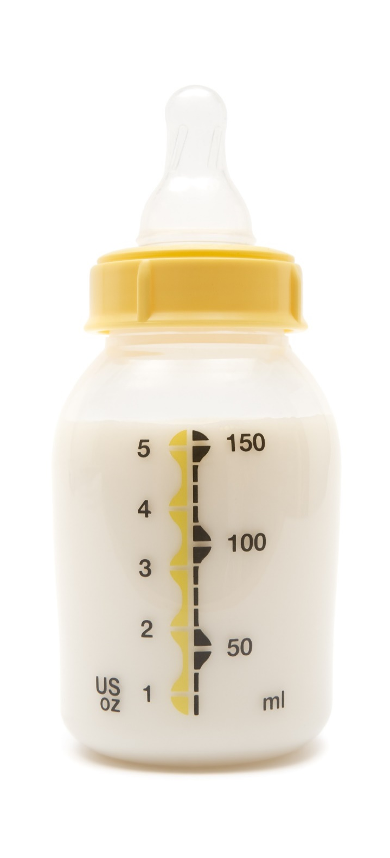
Birth through the End of Five Months
Breast milk or infant formula is the only meal component required
Benefits of breast milk
  Generally, the best source of nutrients
  Protects against illnesses and chronic diseases
Serve a minimum of 4–6 fluid ounces of expressed breast milk or infant formula
Notes:
SHOW SLIDE: Birth through the End of Five Months
SAY:
The next change to the charts focus on the age group, birth through the end of five months. Previously, the breast milk and infant formula was the only required component for the first three months. However, breast milk is the optimal source of nutrients for infants, and it is generally the only source of nutrients infants need for healthy growth and development during the first 6 months of life.
Particularly, breast milk provides the right balance of proteins, healthy fats, vitamins, and other essential nutrients. It also helps to protect infants against illnesses and chronic diseases, such as obesity, asthma, and type 2 diabetes. What’s more, breastfeeding can have a positive effect on their emotional and physical wellbeing. Therefore, the only required meal component for infants between the ages of birth through the end of 5 months is a minimum of 4-6 fluid ounces of expressed breast milk or infant formula for all meals and snacks.

Slide 17

Promotes Developmental Readiness
Delay the introduction of solid foods until around 6 months
Most infants are not ready to consume solid foods until midway through the 1st year
Introducing solid foods too soon increases risk of obesity
Notes:
SHOW SLIDE: Promotes Developmental Readiness
SAY:
The next update to the infant meal pattern focuses on developmental readiness. The previous infant meal pattern allowed solid foods to be introduced as early as 4 months of age. However, if infants are introduced to solid foods before they are developmentally ready, the risk of being overweight or obese later in life increases. Also, infants need time to develop the skills for eating solid foods, and most infants are not ready to consume solid foods until midway through the first year. Therefore, infants may now be introduced to solid foods when they are developmentally ready to accept them. This means you may serve solid foods to infants before, at, or after 6 months of age.

Slide 18
Serving Sizes
0-2 oz.
0-4 tbsp.
Meal components begin with “zero”
  Recognizes that all infants are not ready for solid foods at 6 months
By 7 or 8 months, infants should be consuming solid foods from all food groups
Notes:
SHOW SLIDE: Serving Sizes
SAY:
As you can see on the charts, the serving sizes for all meal components for meals and snacks now begin with “zero” for infants 6 through 11 months, with the exception of breast milk and infant formula. This serving size recognizes that not all infants are ready-to-eat solid foods right at 6 months of age and may need additional time before they are developmentally ready. It is important to note, by 7 or 8 months of age, most infants should consume solid foods from all food groups.
We will explore this topic in detail later in this lesson.

Slide 19

Question: What were some of the FIRST FOODS introduced to infants in the past?
Notes:
SHOW SLIDE: First Foods
ASK:
Shifting to solid foods, what were some of the first foods introduced to infants in the previous meal pattern?
DO:
Allow participants to respond and then, advance to the next screen.

Slide 20
Allows More Nutritious Foods
Foods from all meal components
Breakfast, Lunch, & Supper
  Breast milk or iron-fortified infant formula
  Infant cereal, meats/meat alternates, or a combination of both
  Vegetables or fruits, or a combination of both
Snack
  Breast milk or iron-fortified infant formula
  Grains
  Vegetables or fruits, or a combination of both
Notes:
SHOW SLIDE: Allows More Nutritious Foods
SAY:
[As you just mentioned], the previous meal pattern called for a combination of the following meal components: breast milk or infant formula; infant cereal; and vegetables, fruits, or a combination of both. Also, meats/meat alternates were not introduced until around eight months.
However, the updated meal pattern requirements now allow foods from all the meal components to be served to infants around 6 months, as it is developmentally appropriate. In particular, at breakfast, lunch, and supper meals, the following three meal components must be offered to infants when infants are developmentally ready to accept them:
Breast milk or iron-fortified infant formula
Infant cereal, meats/meat alternates, or a combination
Vegetables, fruits, or a combination of both
During snacks, there are three meal components:
Breast milk or iron-fortified infant formula
Grains
Vegetables, fruits, or a combination of both

Slide 21

Review of Changes
What are the two age groups?
What is the only required food or beverage for infants between the ages of birth through the end of five months?
When can infants be introduced to solid foods?
When infants are first introduced to solid foods, which meal components are not allowed for a reimbursable meal or snack?
Notes:
SHOW SLIDE: Review of Changes
DO: (Large Group Discussion) Review of Changes
SAY: Now that we have explored the basics changes to the infant meal pattern charts, let’s review what you’ve learned.
DO: Read each of the questions below; then, allow the participants to respond. The answers are listed below each question.
What are the two age groups for the infant meal pattern?
Birth through the end of 5 months
6 months through the end of 11 months
What is the only required food or beverage for infants between the ages of birth through the end of five months?
Breast milk or infant formula
When can infants be introduced to solid foods?
When infants are developmentally ready to accept solid foods
Before, at, or around 6 months
When infants are first introduced to solid foods, which meal components are not allowed for a reimbursable meal or snack?
There are no restricted meal components when introducing solid foods. Infants may be served foods from all meal components as part of a reimbursable meal.
SAY:
The basic changes to the actual infant meal pattern charts influence other updates to the meal pattern. Keep these changes in mind as we advance through this training. We will explore them more, along with strategies for implementation.

Slide 22

Breast Milk & Infant Formula
Promote breastfeeding by allowing reimbursement when:
  A parent/guardian supplies expressed milk
    Milk that is produced and expelled from the breast
  A mother breastfeeds her infant on-site
Notes:
SHOW SLIDE: Breastmilk and Infant Formula
SAY:
Now that we have explored the basic changes to the infant meal pattern charts, let’s explore the updated requirements, as well as some requirements that remain the same, for breast milk and infant formula.
As previously mentioned, breast milk is generally the best source of nutrients for healthy growth and development. Due to the many benefits of breast milk, the updated requirements encourage and promote breastfeeding in two key ways. First, you may continue to claim infant meals for reimbursement when a parent or guardian supplies expressed breast milk (milk that is produced and expelled from the breast) for their infant and you feed the infant the expressed milk. Second, you may claim reimbursement for meals when a mother breastfeeds her infant at the child care facility.

Slide 23

Serving Expressed Breast Milk
Breastfed infants may not consume the entire serving
Reimbursable:
  Offer less than the minimum serving size of breast milk
  Offer additional breast milk later, if infant will consume more
Feed on demand
Notes:
SHOW SLIDE: Serving Expressed Breast Milk
SAY:
Focusing on serving expressed breast milk first, there may be times when an infant does not consume the entire serving. For example, some breastfed infants consume less than the minimum serving size of breast milk for each feeding. In these situations, you may offer infants less than the minimum serving size of breast milk. However, you must offer the additional expressed breast milk later, if the infant will consume more, for a reimbursable meal.
Although not new, it is important to note you should always feed infants on demand and not on a strict schedule. Feed infants during a span of time, consistent with their eating habits. In addition, avoid force-feeding infants, as this may cause them to consume more than they need.

Slide 24

Breastfeeding
On-Site
Claim reimbursement for meals when a mother breastfeeds her infant at the child care site…
Notes:
SHOW SLIDE: Breastfeeding On-Site
SAY:
As previously mentioned, you may claim reimbursement for meals when a mother breastfeeds her infant at the child care site. A great way to encourage mothers to breastfeed on-site is to establish a private, comfortable, and sanitary area.
Mothers may choose to breastfeed their infant in the designated area or in a different area on-site. For example, a mother chooses to breastfeed in her car or in a private office because the established area is in use. This meal is still reimbursable as long as she is on-site while breastfeeding.

Slide 25

Documenting On-site Breastfeeding
Write on the menu or meal count form:
  “Infant was offered breast milk”
  “Breastfed on-site”
  “Mother on-site”
Contact your State agency for the best way to document on-site breastfeeding
Notes:
SHOW SLIDE: Documenting On-site Breastfeeding
SAY:
You may be wondering, how do you document when a mother breastfeeds on-site or will this update pose additional paperwork? The great news about documentation and on-site breastfeeding is there are several ways to demonstrate compliance with this update.
It is not a requirement to measure and record the amount of breast milk a mother breastfeeds her infant. You may simply write on the menu or meal count form:
“Infant was offered breast milk”
“Breastfed on-site”
“Mother on-site”
It is important to note that State agencies have the authority to determine what is appropriate documentation to demonstrate compliance with the meal pattern requirements. For additional information on the best way to meet documentation requirements, contact your State agency.
NOTE TO INSTRUCTOR:
If you have State agency staff in your training, you may wish to tell them that they may choose to update existing forms to document when a mother breastfeeds her infant on-site as a way to reduce the need for additional paperwork.
If you are State agency staff, you may wish to describe your State’s infant meal documentation requirements.

Slide 26

Iron-Fortified Infant Formula
Best supplement for breast milk
Supports healthy brain development & growth
Reimbursable meals may include:
  Iron-fortified formula
  Breast milk
  Combination of both
Notes:
SHOW SLIDE: Iron-Fortified Infant Formula
SAY:
When infants are not breastfed or they need a supplement for breast milk, iron-fortified infant formula is the best alternative. Iron is an important nutrient for infants during their first year because it supports healthy brain development and growth.
The infant meal pattern requirements allow an infant, younger than 12 months, to be served iron-fortified formula, breast milk, or a combination of both. Therefore, if a mother chooses not to breastfeed or is unable to produce enough breast milk to satisfy the infant, serve iron-fortified formula. In this case, always have a conversation with the parent or guardian regarding the program requirements to ensure that they understand and are in agreement with serving the formula.

Slide 27


Supplying Formula
Offer a minimum of 1 type of iron-fortified infant formula
Formula must be regulated by FDA
  It credits if marketed or purchased in the U.S.
  May not credit if purchased outside U.S.
Notes:
SHOW SLIDE: Supplying Formula
SAY:
All child care programs must continue to offer a minimum of one type of iron-fortified infant formula. Also, the selected formula must be regulated by the Food and Drug Administration (FDA) to be creditable in the CACFP.
The great news is any formula marketed or purchased in a store in the U.S. is regulated by the FDA. However, if you purchase an infant formula outside of the U.S., such as thru an online store with vendors in other countries, it may not be regulated by the FDA. In these cases, the formula may not credit in the CACFP.
You can find more information on selecting creditable infant formula on the Creditable Infant Formula handout in your Participant’s Workbook.

Slide 28

Serving Formula
Infants may not drink the entire serving of formula
  Reimbursable if the minimum serving size is offered
Any leftovers should be properly stored in accordance with local health and safety requirements
Notes:
SHOW SLIDE: Serving Formula
SAY:
When serving formula, some infants may not consume the entire serving. However, if you offer the minimum serving size, the meal is reimbursable. This is true for any food or beverage served to all participants (infant, children, and adults) in the CACFP. A participant does not need to consume the minimum serving size of a food component for the meal to be reimbursable.
In situations where there are leftovers, always properly store them based on your local health and safety requirements.

Slide 29
Disabilities and Modifications
Must make reasonable accommodations for participants with a disability
CACFP 14-2017: Modifications to Accommodate Disabilities in the Child and Adult Care Food Program and Summer Food Service Program
CACFP 06-2017: Feeding Infants and Meal Pattern Requirements in the Child and Adult Care Food Program; Questions and Answers
Notes:
SHOW SLIDE: Disabilities and Modifications
SAY:
Due to a disability, some infants may not be able to consume breast milk or iron-fortified infant formulas, as well as other foods outlined in the meal pattern. In these situations, you must make reasonable accommodations.
In addition to working with your State agencies for making reasonable accommodations, there are two key policies memos that feature information on meeting the needs of infants requiring modified meals.
CACFP 14-2017 Modifications to Accommodate Disabilities in the Child and Adult Care Food Program and Summer Food Service Program
CACFP 06-2017 Feeding Infants and Meal Pattern Requirements in the Child and Adult Care Food Program; Questions and Answers
You can find the link to these memos on the Training Resources handout in the Appendix of your Participant’s Workbook. For additional information, always refer to your State agency or sponsoring organization.

Slide 30

Medical Statements
Required when modifications do not meet the meal pattern requirements
Signed by a State licensed healthcare professional or registered dietitian
Notes:
SHOW SLIDE: Medical Statements
SAY:
The medical statement is an essential tool for serving reimbursable meals to those requiring modifications. In many cases, disabilities can be managed within the meal pattern requirements when a well-planned variety of nutritious foods is available to participants. For example, an infant is allergic to apples; you could work with the parents to identify an alternative food, such as oranges. In these cases, a medical statement is not required for meal modifications that meet the meal pattern requirements.
However, a medical statement is required when the accommodation calls for serving a specific food or an entire meal that does not meet the meal pattern requirements. For example, if an infant’s disability is an infant formula that is not iron-fortified, a medical statement is required for reimbursement. In these situations, request a written medical statement, signed by a State licensed healthcare professional (an individual authorized to write medical prescriptions under State law) or registered dietitian.

Slide 31

Medical Statements: What to Look for?
Key factors:
  Enough information about the participant’s disability
  Recommends alternate food items
Review it carefully and ask questions
Keep medical statement(s) on file to receive reimbursement
Notes:
SHOW SLIDE: Medical Statements – What to Look For?
SAY:
A medical statement should feature two key factors:
Enough information about the participant’s disability to allow you to understand how it affects their diet
Recommends alternate food items to ensure you know just what you can serve to the participant
Once you receive a medical statement, review it carefully to make sure that it provides the necessary information for meeting the needs of those requiring meal modifications. If it does not, request additional information to ensure you know how to best meet the needs of those requiring modifications. In addition, always keep all medical statements on file in your facility.

Slide 32

Activity: Pair & Share
Notes:
SHOW SLIDE: Activity: Pair and Share
DO:(Workbook Activity): Pair and Share
Purpose: The purpose of this activity is to ensure participants have the opportunity to summarize key requirements and how to apply the information.
Materials Needed: Discussion Highlights: Pair and Share and a pencil or pen
Time: 5–10 minutes
Instructions:
SAY: Now that we have reviewed the requirements for breast milk and formula for the infant meal pattern requirements, let’s review what you learned. Turn to your neighbor and summarize at least two key requirements for breast milk and infant formula, and how you will apply this information.
DO: Allow 3-5 minutes for participants to share and then, ask volunteers to share their responses. Refer participants to the Pair and Share worksheet in their Participant’s Workbook to list any key points noted during the discussion.
FEEDBACK: There are no right or wrong answers for this activity. However, some potential responses might include those noted in the following Answer Key: Pair and Share.

Slide 33

Break
Notes:
SHOW SLIDE: Break 1
DO:
Break 1
Time: 10-15 minutes
Instructions:
SAY: Let’s take a 10-minute break. Be back at (time). Remember, the restrooms are located (state location).
DO: Review any questions on the Bike Rack. After the break, respond to any posing questions.

Slide 34

Importance of Developmental Readiness
Serve solid foods when infants are developmentally ready
Before, at, or after 6 months of age
Notes:
SHOW SLIDE: Developmental Readiness
SAY:
Introducing solid foods is a very important step for infants, parents, and guardians. It is vital that infants are developmentally ready for solid foods before introducing them. As previously mentioned, infants will be developmentally ready to accept solid foods before, at, or after 6 months of age.
By 7 or 8 months of age, most infants should consume solid foods from all food groups. However, infants develop at their own rate. This means if an 8-month-old is not developmentally ready for solid foods, the meal or snack is still reimbursable providing you serve the minimum serving size (6–8 fluid ounces) for breast milk or infant formula.

Slide 35


Parent Communication
The American Academy of Pediatrics developmental readiness guidelines
Optional written statement
Approved meal components
Notes:
SHOW SLIDE: Parent Communication
SAY:
It is important to consult with parents or guardians about when and what solid foods to introduce to their infant. This approach helps to ensure that all newly introduced foods are appropriate for each infant and consistent with their eating habits.
There are three key topics you may wish to discuss with parents:
The American Academy of Pediatrics (AAP) developmental readiness guidelines
Optional written statement
Approved food components
Let’s review each of these topics in details.

Slide 36

American Academy of Pediatrics
Sits in chair with good head control
Opens mouth for food
Moves food from a spoon into throat
Doubles in birth weight
Notes:
SHOW SLIDE: American Academy of Pediatrics
SAY:
First, the American Academy of Pediatrics (AAP) is the leading authority for children’s development and nutrition needs from birth through 23 months of age. They found that there is no direct signal to determine when an infant is developmentally ready to accept solid foods. However, the AAP provides these guidelines to help determine when an infant is developmentally ready to accept solid foods.
When communicating with parents and guardians about developmental readiness, you may wish to use the AAP’s developmental readiness guidelines. These guidelines state that an infant may be developmentally ready to accept solid foods when he or she:
is able to sit in a high chair, feeding seat, or infant seat with good head control;
opens their mouth when food comes their way. The infant may watch others eat, reach for food, and seem eager to be fed;
moves food from a spoon into the throat; and
doubles in weight.
You can find more information on the Developmental Readiness handout in your Participant’s Workbook.

Slide 37

Optional Written Statement
Request a written statement from parents or guardians:
  outlining when & which solid foods to serve
Follows the preferences of parents & guardians
Notes:
SHOW SLIDE: Optional Written Statement
SAY:
Next, there is the optional written statement for infant meals. The updated requirements recommend a written statement from parents or guardians, outlining when and which solid foods to serve to their infant. Although not a requirement, this optional statement will help you to know what to do to meet the needs of the infants and follow the preferences of the parents and guardians.
ASK:
How many of you use infant statements in your program? How does it help you?
DO:
Allow participants to respond and then, advance to the next slide.

Slide 38
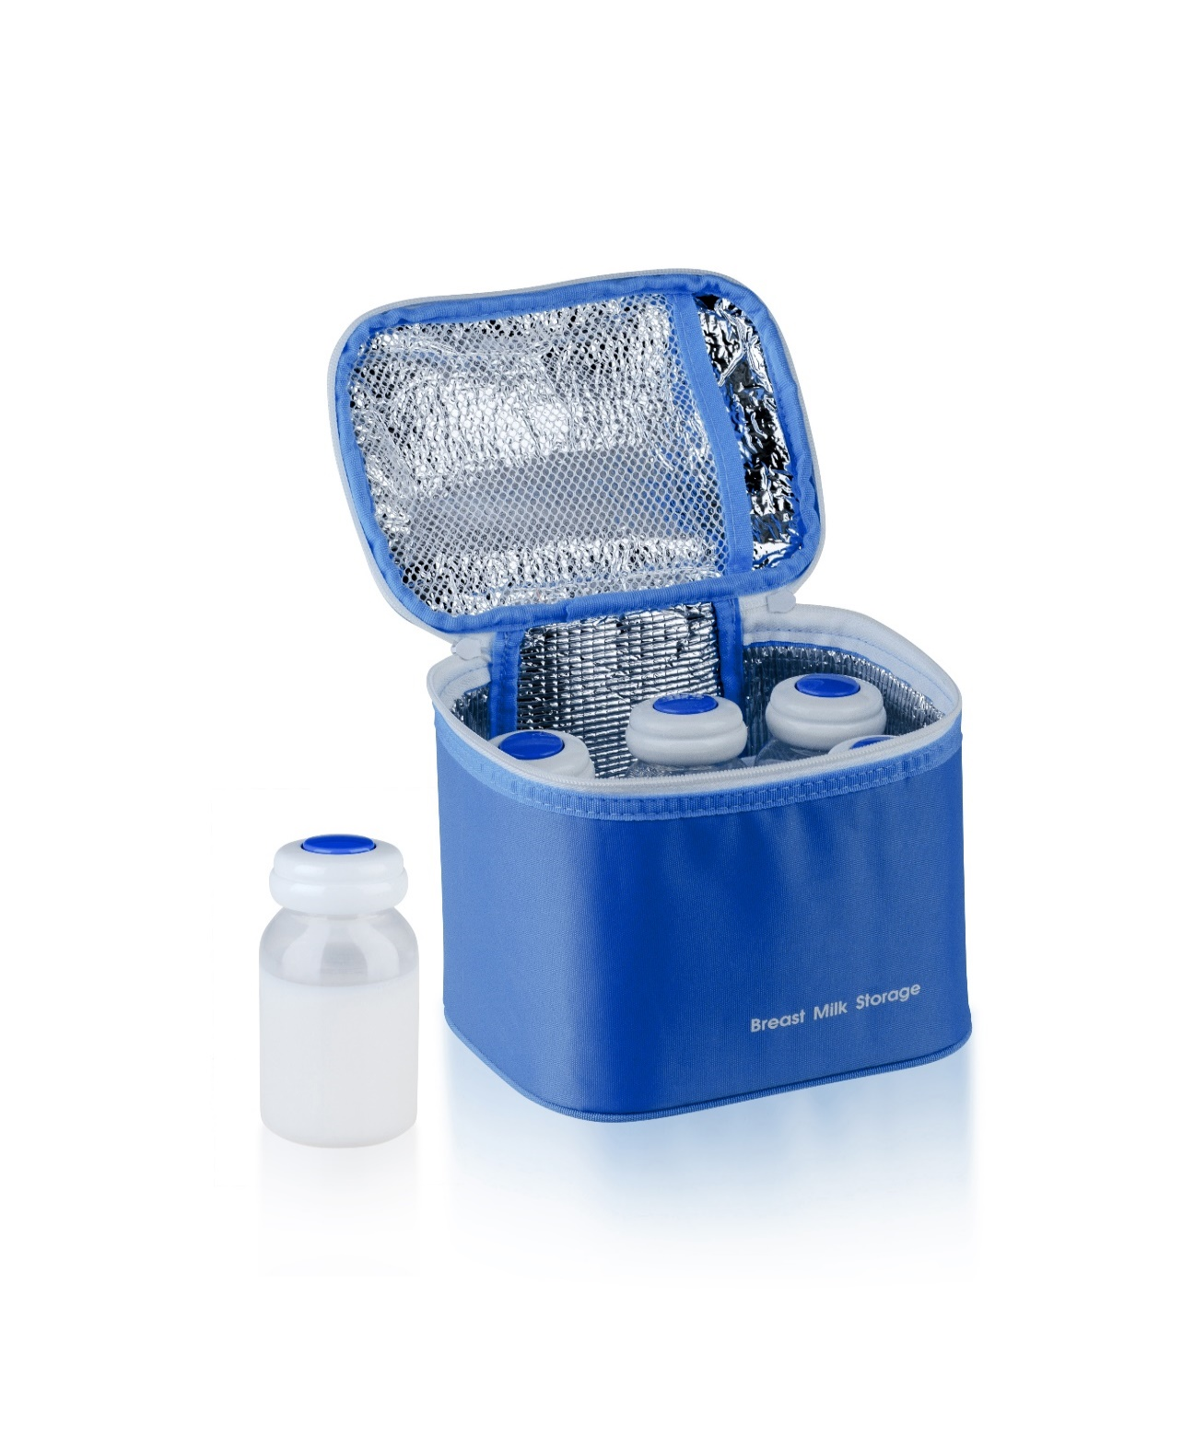
Meal Components
Parents/guardians may provide only one creditable meal component for a reimbursable meal
  breast milk = 1 component
Operators must provide remaining components
Notes:
SHOW SLIDE: Meal Components
SAY:
Last, discuss the total meal components parents or guardians may provide for a reimbursable meal.
Previously, a parent or guardian could provide all, but one component and the meal would be reimbursable. However, the updated requirements allow parents and guardians to provide only one meal component for a reimbursable infant meal. As the operator, you must provide the remaining components for meals and snacks.

Slide 39


Single Meal Component
Must be creditable and in the minimum serving size
Not creditable if parent or guardian provides
  two or more components
  less than the minimum serving sizes
  a non-creditable food item
Notes:
SHOW SLIDE: Single Meal Component
SAY:
To meet this requirement, the single item must be creditable and, in the minimum, serving size. For example, if a mother provides green beans in the minimum serving size on the days in which black beans are served at lunch the green beans will credit toward a reimbursable meal.
On the other hand, the meal or snack is not reimbursable if a parent or guardian chooses to provide:
two or more components,
less than the minimum serving sizes, or
a non-creditable food item.

Slide 40

Question: What are some other topics to discuss with parents or guardians?
Notes:
SHOW SLIDE: Additional Questions
ASK:
In addition to these topics, are there any other topics you may wish to discuss with parents or guardians?
DO:
Allow participants to respond and then, advance to the next slide.

Slide 41

Introducing Solid Food(s)
Solid foods must be offered after
  developmentally ready AND communicated with parents
Gradually introduce solid foods
  One at a time
  Over the course of a few days
Notes:
SHOW SLIDE: Introducing Solid Food(s)
SAY:
﻿Once an infant is developmentally ready to accept solid foods and you have communicated with the parents, you must offer the food to the infant. Begin by gradually introducing solid foods, one at a time, and over the course of a few days. It may be appropriate to offer a solid food at only one meal per day when an infant is just starting to eat them. Also, it is not necessary to offer an infant a solid meal component at every meal or snack, such as vegetables and fruits, until the infant has established a tolerance for that meal component.
As previously mentioned, the meal is reimbursable as long as it consistent with the eating habits of the infant.

Slide 42

Introducing Solid Food(s) (cont.)
Prepare foods in the right texture and consistency
Observe infants closely for reactions after feeding a new food
Notes:
SHOW SLIDE: Introducing Solid Food(s) (cont.)
SAY:
In addition to gradual introduction, here are a few other measures for ensuring infants have the best experiences when consuming solid foods.
Prepare foods in the right texture and consistency, appropriate for the age and development of each infant; and
Observe each infant closely for reactions after feeding a new food. If there is a reaction, stop feeding the food and discuss this with the parents or guardians. Consult with the parents or guardians, who should contact their baby’s doctor, before introducing that food in the future.
For additional ways to introduce solid foods to infants, refer to the Feeding Infants: A Guide for Use in the Child Nutrition Programs. You can find a link to this resource listed on the Training Resources handout in the Appendix of your Participant’s Workbook.

Slide 43

Activity: Apply in Three
Notes:
SHOW SLIDE: Activity: Apply in Three
DO:
(Workbook Activity): Apply in Three
Purpose: The purpose of this activity is to ensure participants identify the most important information from this section of the training.
Materials Needed: Apply in Three worksheet, pen or pencil
Time: 5–10 minutes
Instructions:
SAY: Now that we have explored the updated requirements for developmental readiness, let’s complete an activity that allows you to apply what you learned. Turn to the Apply in Three worksheet in your Participant’s Workbook. Write at least three things you learned about supporting developmental readiness and how to apply this information in your child care setting. Once you have finished, find someone from a different group and share your strategies.
DO: Allow 3–5 minutes for participants to complete this activity. Then, request volunteers to share their responses.
FEEDBACK: There are no right or wrong answers for this activity. However, some potential responses might include those noted in the following Answer Key: Apply in Three.

Slide 44
Break
Notes:
SHOW SLIDE: Break 2
DO:
Break 2
Time: 10-15 minutes
Instructions:
SAY: Let’s take a 10-minute break. Be back at (time). Remember, the restrooms are located (state location).
DO: Review any questions on the Bike Rack. After the break, respond to any posing questions.

Slide 45
Serving More Nutritious Foods
Serve a vegetable or fruit at snack
Juice, cheese food, and cheese spreads are not creditable items
Yogurt, soy yogurt, tofu, and whole eggs credit as meat alternates
Deep-fat frying is not allowed when cooking foods on-site
Notes:
SHOW SLIDE: Serving More Nutritious Foods
SAY:
Now that we have discussed developmental readiness, let’s shift our focus to the updated requirements on adding more nutritious options to infant meals and snacks. As previously mentioned, there are four updates for serving more nutritious foods to infants:
Serve a vegetable or fruit at snack
Juice, cheese food, and cheese spreads are not creditable items
Yogurt, soy yogurt, tofu, and whole eggs credit as meat alternates
Deep-fat frying is not allowed when preparing meals or snacks on-site
Let’s review each of these updates and some key strategies for implementation.

Slide 46

Vegetables & Fruits
Great source of essential nutrients
  i.e., fiber & vitamin C
Minimum serving size: 0-2 tbsp.
Required at all meals & snacks
  Serve vegetable, fruit, or a combination of both
  Increases consumption & allows for better acceptance later in life
Notes:
SHOW SLIDE: Vegetables and Fruits
SAY:
The first update focuses on the vegetables and fruits component. Vegetables and fruits are great sources of essential nutrients, such as fiber and vitamin C. Currently, vegetables and fruits are required at breakfast, lunch, and supper meals for infants who are developmentally ready to accept them (around 6 months of age). In the updated infant meal pattern requirements, 0–2 tablespoon(s) of vegetables, fruits, or a combination of both must be offered during snacks when infants are developmentally ready to accept them. This change promotes vegetable and fruit consumption in infants, and it allows for better acceptance later in life.

Slide 47

Juice
X
Lacks dietary fiber found in other forms of fruits & vegetables
Does not credit toward a reimbursable meal for infants
Notes:
SHOW SLIDE: Juice
SAY:
Juice lacks the dietary fiber found in other forms of fruits and vegetables. When infants drink too much juice, they are more likely to experience diarrhea, abdominal pain, and other gastrointestinal problems. Therefore, juice is not creditable as part of a reimbursable infant meal or snack.
For additional information on the vegetables and fruits components, refer to the policy memos CACFP 06-2017 Feeding Infants and Meal Pattern Requirements in the Child and Adult Care Food Program; Questions and Answers or the CACFP 09-2017 Vegetable and Fruit Requirements in CACFP: Q&A for the current policies. You can find the link to this memo on the Training Resources handout in the Appendix of this course.

Slide 48




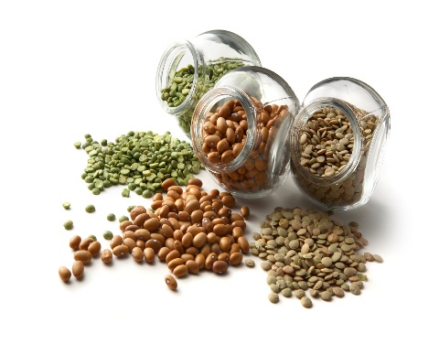
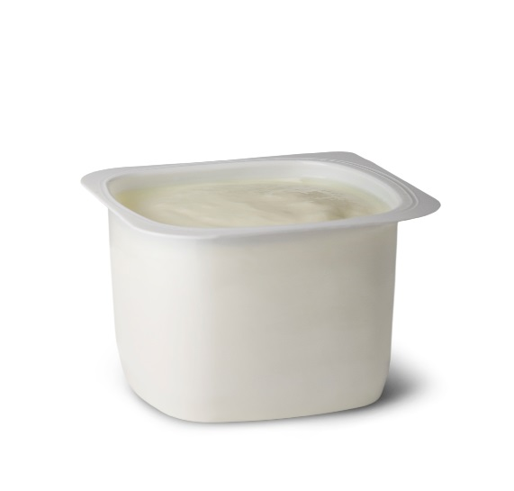
Meats/Meat Alternates
Meats
Yogurt and Soy Yogurt
Cheese
Whole eggs
Beans, peas, lentils
Tofu
Notes:
SHOW SLIDE: Meat/Meat Alternates
SAY:
The next update focuses on the meats/meat alternates component. Some common examples of meats/meat alternates include meats, yogurt, cheese, whole eggs, and beans, peas, and lentils.
The specific updates to this component focus on yogurt, soy yogurt, tofu, whole eggs, and cheese foods and spreads. Let’s begin by exploring yogurt.

Slide 49

Yogurt and Soy Yogurt
Great source of protein
Minimum serving size: 0-4 oz
May serve during breakfast, lunch, or supper
Notes:
SHOW SLIDE: Yogurt and Soy Yogurt
SAY:
Yogurt, including soy yogurt, is a great source of protein, and this macronutrient provides energy, builds and maintains muscle, and it promotes a healthy metabolism. Because of the benefits of protein and the popularity of yogurt, it credits as a meat alternate for infants as they are developmentally ready to accept it. When serving yogurt and soy yogurt, serve 0–4 ounces during breakfast, lunch, or supper meals.

Slide 50


Yogurt & Added Sugars
Added Sugars Limit:
  Current: No more than 23 grams of total sugar per 6 oz
  Effective October 1, 2025: no more than 12 grams of added sugars per 6 ounces
Notes:
SHOW SLIDE: Yogurt and Added Sugars
SAY:
Although a great source of protein, some yogurts have significantly more sugar than others. Exposing infants to high amounts of sugar early on, can have a negative influence on eating habits. As a result, the updated requirements limit the amount of added sugars creditable yogurts may contain to promote healthy habits from the start. Moreover, yogurt and soy yogurt must meet the CACFP added sugars limit. Through September 30, 2025, yogurt must contain no more than 23 grams of total sugars per 6 ounces. By October 1, 2025, yogurt must contain no more than 12 grams of added sugars per 6 ounces (2 grams of added sugars per ounce).

Slide 51
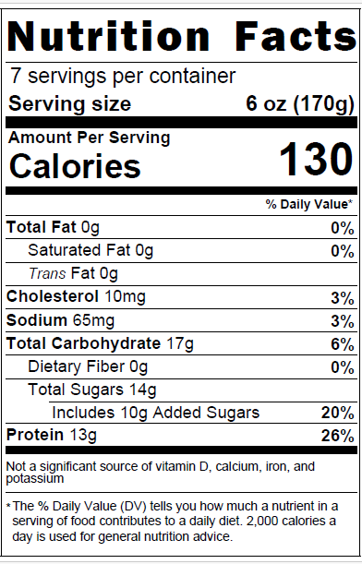
Nutrition Facts Label
Helpful for identifying nutritious foods
  Example: Yogurt
Found on packaged foods
Notes:
SHOW SLIDE: Nutrition Facts Label
SAY:
The first step in determining yogurt products that meet the added sugars limit is to know exactly what to look for on the Nutrition Facts label. This step is helpful in identifying nutritious foods that align with the meal pattern requirements.

Slide 52
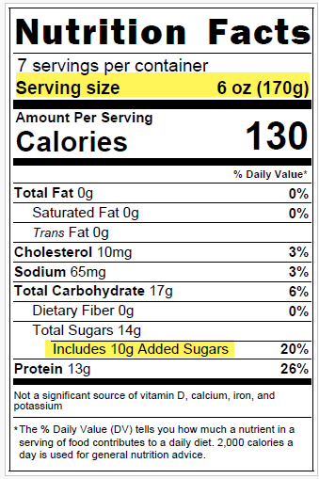
Key Terms
Serving Size
  Number of servings in a package
  Unit: ounces, cups, per container, etc.
Added Sugars
  Amount per serving
Notes:
SHOW SLIDE: Key Terms
SAY:
When reading Nutrition Facts labels to determine if the product meets the added sugars requirements, there are two key terms to look for: Serving Size and Added Sugars. The serving size is the number of servings in a food package, in which the serving size is provided in units, such as ounces, cups, or container. The serving size is also provided in grams in parenthesis. When reading labels for yogurt, always use the number beside Added Sugars.

Slide 53
Table Method: Yogurt
Yogurt Added Sugars Limits
Serving Size (Ounces) | Serving Size (Grams) | Added Sugars Limit
2.25 ounces | 64 grams | 4 grams
3.5 ounces | 99 grams | 7 grams
4 ounces | 113 grams | 8 grams
5.3 ounces | 150 grams | 10 grams
6 ounces | 170 grams | 12 grams
8 ounces | 227 grams | 16 grams
Notes:
SHOW SLIDE: Table Method: Yogurt
SAY:
There are many ways to determine if a yogurt meets the added sugars limit. Today, we will explore the table method for yogurt as it is the easiest and the fastest way for determining if a yogurt item meets the added sugars limit requirement. This method features a table with common sizes of yogurt and the pre-calculated added sugars limit for each size. For your reference, you can find this method on the Yogurt and Added Sugars Guide handout, as well as a link to the USDA’s training worksheets, in your Participant’s Workbook.
As you can see in this table, there are three major columns.
The left column, Serving Sizes (Ounces) is used when a yogurt’s Nutrition Facts label lists the serving size in ounces, such as 6 ounces or 8 ounces.
The middle column, Serving Sizes (Grams), is used when the Nutrition Facts label’s serving size is not in ounces, but in cups, containers, or other units. In situations such as these, you can use the number in parenthesis, the grams, to determine if the yogurt is within the added sugars limit.
The right column lists the added sugars limits for each serving size.
The table method was adapted from the USDA Team Nutrition’s training worksheet “Choose Yogurts That Are Low in Added Sugar.” You can find a link to this resource on the Training Resources handout in the Appendix of your Participant’s Workbook.

Slide 54
Table Method Steps
Step 1: Find the Serving Size, in ounces (oz) or grams (g): 6 oz
Step 2: Find the amount for Added Sugars: 10 grams
Notes:
SHOW SLIDE: Table Method Steps
SAY:
This method features four steps.
First, use the Nutrition Facts label on the yogurt to find the Serving Size, in ounces (oz) or grams (g). In this case, the Serving Size is 6 ounces.
Next, look at the number next to Added Sugars. There are 10 grams of added sugars in this package per serving.

Slide 55
Table Method Steps (cont.)
Yogurt Added Sugars Limits Table
Serving Size (Ounces) | Serving Size (Grams) | Added Sugars Limit
2.25 ounces | 64 grams | 4 grams
3.5 ounces | 99 grams | 7 grams
4 ounces | 113 grams | 8 grams
5.3 ounces | 150 grams | 10 grams
6 ounces | 170 grams | 12 grams
8 ounces | 227 grams | 16 grams
Step 3: Find serving size in Added Sugars Limits Table
Step 4: Look at number to right of serving size, under “Added Sugars Limit” column
  Serving size: 6 oz
  Added sugars: 10 grams
Notes:
SHOW SLIDE: Table Method Steps (cont.)
SAY:
Then, locate the yogurt’s Serving Size in the “Serving Size in Ounces” column on the “Added Sugars Limits Table.” In this case, it is 6 ounces.
Last, look at the number to the right of the serving size amount, under the “Added Sugars Limit” column in the table. If your yogurt has that amount of added sugars, or less, the yogurt meets the added sugars requirement.
DO:
Encourage participants to look at the Added Sugars Limits Table to determine if the yogurt is within the added sugars limit requirements. Then ask is this yogurt creditable?

Slide 56
Is it Creditable?
Yogurt Added Sugars Limits Table
Serving Size (Ounces) | Serving Size (Grams) | Added Sugars Limit
2.25 ounces | 64 grams | 4 grams
3.5 ounces | 99 grams | 7 grams
4 ounces | 113 grams | 8 grams
5.3 ounces | 150 grams | 10 grams
6 ounces | 170 grams | 12 grams
8 ounces | 227 grams | 16 grams
Yes, it is creditable—
10 grams is less than the 12 grams added sugars limit!
Notes:
SHOW SLIDE: Is it Creditable?
SAY:
According to the table, for a 6-ounce serving, the added sugars limit is 12 grams of added sugars. Therefore, this item is creditable because the added sugars amount, 10 grams, is less than the added sugars limit of 12 grams.

Slide 57
Serving Size in Grams
Yogurt Added Sugars Limits Table
Serving Size (Ounces) | Serving Size (Grams) | Added Sugars Limit
1 ounce | 28 grams | 2 grams
1.5 ounces | 43 grams | 3 grams
2 ounces | 57 grams | 4 grams
2.5 ounces | 71 grams | 5 grams
3 ounces | 85 grams | 6 grams
4 ounces | 113 grams | 8 grams
Serving size:
½ cup (85g)
Added Sugars: 9 grams
Not Creditable
9g is more than 6g added sugars limit
Notes:
SHOW SLIDE: Serving Size in Grams
SAY:
Sometimes you may find yogurts that do not list the serving size in ounces, but in cups or grams. In the second example, this yogurt label lists “1/2 cup (85 grams)” as the serving size and “9 grams” for added sugars. Using the middle column in the Yogurt Added Sugars Limits Table, this product would not be creditable because 9 grams of added sugars is not within the added sugars limit requirements of 0-6 grams for a product with 85 grams per serving size.
Some yogurts may list the serving size as one container and not list ounces and grams on the Nutrition Facts label. In these cases, refer to the front of the package, to see how many ounces or grams are in the container.
NOTE TO INSTRUCTOR: The following Yogurt Added Sugars Limits Table highlights the second example used in this slide. This table is listed at the bottom of the Yogurt and Added Sugars Guide handout, and it is meant to be used as a reference only.

Slide 58

Activity: Yogurt–Is it Creditable?
Notes:
SHOW SLIDE: Activity: Yogurt, Is it Creditable?
DO:(Workbook Activity): Yogurt, Is it Creditable?
Purpose: The purpose of this activity is to provide an opportunity to practice identifying yogurt products that meet the added sugars limit requirements for the CACFP.
Materials Needed: Yogurt, Is it Creditable? worksheet, and pen or pencil
Time: 10–15 minutes
Instructions:
SAY: Please turn to the Yogurt, Is it Creditable? worksheet in your Participant’s Workbook. Use the Added Sugars Limits Table to determine if the yogurt is creditable.
DO: Allow 5–10 minutes for the participants to complete the assignment. Then use the Answer Key: Yogurt, Is it Creditable? to review the answers with the participants.

Slide 59

Whole Eggs
AAP found no convincing evidence to delay foods considered major food allergens
Whole eggs are now creditable for infant meals
Minimum serving size: 0-4 tbsp.
Notes:
SHOW SLIDE: Whole Eggs
SAY:
Eggs are a great source of protein. Previously, there was a concern that the protein in egg whites may cause an allergic reaction. However, the AAP concluded that there is no convincing evidence to delay the introduction of foods that are considered major food allergens such as eggs. Therefore, the updated infant meal pattern requirements allow 0–4 tablespoons of whole eggs to credit toward a reimbursable meal.
It is important to note that when serving eggs, you must serve the whole egg, serving only egg yolks or only egg whites is no longer creditable in CACFP.

Slide 60

Cheese
Minimum serving sizes:
  cheese: 0–2 oz
  cottage cheese: 0–4 oz (volume)
Common examples of cheese:
  Shredded or sliced Swiss, Colby, & Monterey Jack
Notes:
SHOW SLIDE: Cheese
SAY:
Next, 0–2 ounces of cheese and 0–4 ounces (volume) cottage cheese credits as a meat alternate. Some common examples of cheese may include shredded or sliced Swiss, Colby, and Monterey Jack.

Slide 61
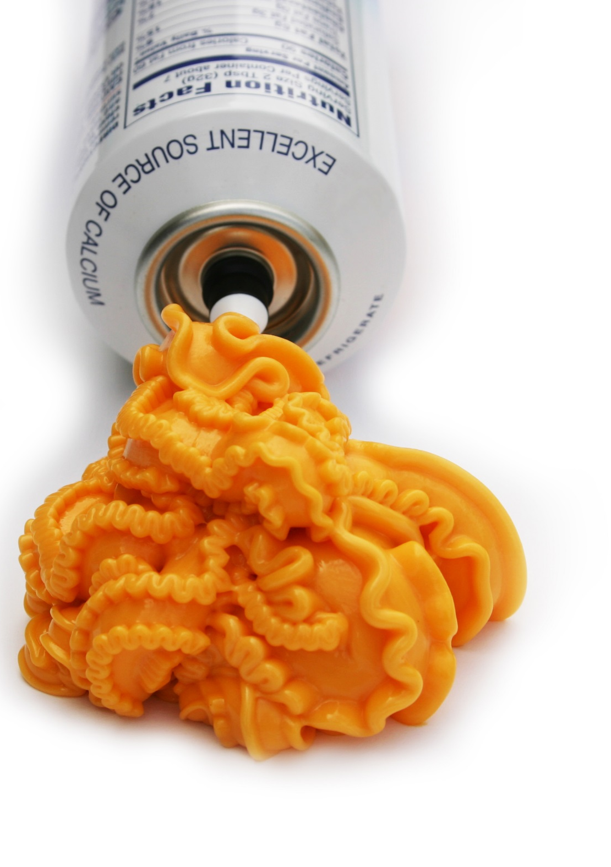
Cheese foods & cheese spreads are not creditable for infant meals & snacks…
Notes:
SHOW SLIDE: Cheese Foods and Cheese Spreads
SAY:
Certain cheese items have significantly higher amounts of sodium than others. Eating too many foods high in sodium can lead to heart disease, stroke, and hypertension. Therefore, the infant meal pattern requirements do not allow the service of cheese foods or cheese spreads for infant meals. It is important to note, cheese foods are still allowable for children and adults.

Slide 62
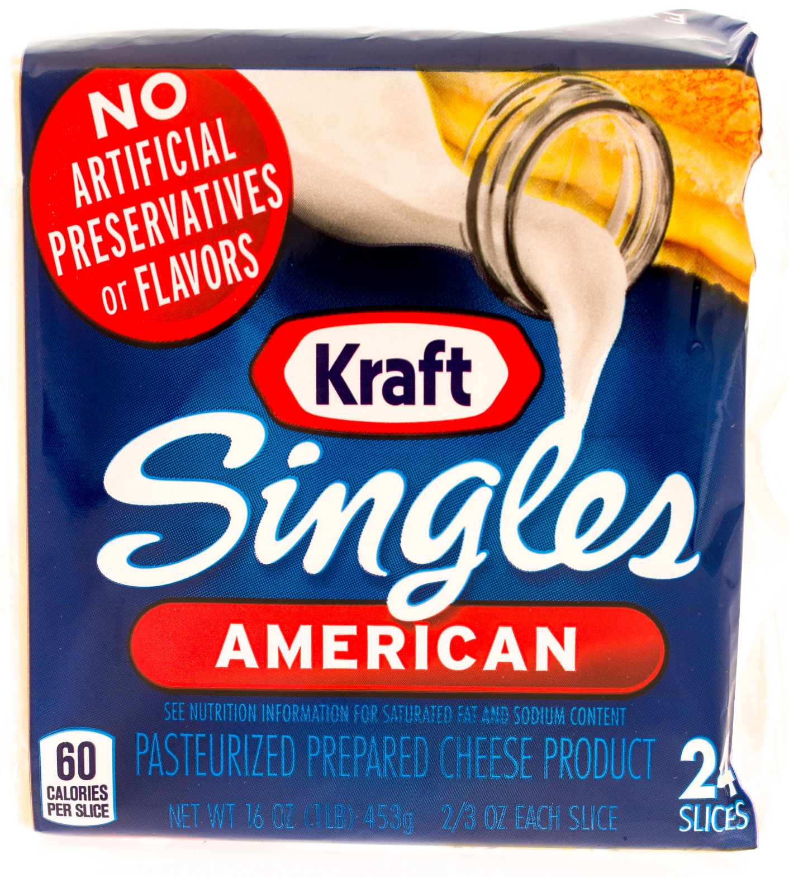
Non-Creditable Cheese Foods
Product packaging states:
  “Imitation cheese”
  “Cheese food”
  “Cheese product”
Common items
  Cheese whips
  Cheese with pimento
  Cream cheese
Notes:
SHOW SLIDE: Non-Creditable Cheese Foods
SAY:
Non-creditable items may be identified by reading the product’s packaging for the wording “imitation cheese,” “cheese food,” or “cheese product” on the food label, such as:
• cheese whips,
• cheese with pimento, and
• cream cheese.
Refer to the USDA Food Buying Guide for Child Nutrition Programs to help you identify approved cheese items. You can find a link to this resource on the Training Resources handout in the Appendix of your Participant’s Workbook.

Slide 63

Tofu
Credits as meat alternate
Commercially prepared
Easily recognized as meat substitute
Five grams of protein per 2.2 oz (¼ cup) = 1 oz M/MA
Notes:
SHOW SLIDE: Tofu
SAY: The last meat/meat alternate topic we’ll discuss is tofu. There are three requirements for ensuring tofu is creditable as a meat alternate.
Tofu products must be commercially prepared. Homemade tofu would not credit because it is not commercially prepared.
Tofu must be easily recognizable as a meat substitute. Some allowable ways to use tofu might include tofu links, tofu sausages, tofu cubes in stir-fry, or tofu omelets. Tofu noodles or soft or silken tofu in smoothies are not creditable.
Tofu must contain 5 grams of protein per 2.2 ounces (¼ cup) to credit as 1 ounce of the M/MA.

Slide 64

Grains
Great source of essential nutrients
Serve at meals & snacks when infants are developmentally ready
Minimum serving size: 0–4 tbsp
Notes:
SHOW SLIDE: Grains
SAY:
The next meal component for infants is grains. During the first year, grains, such as iron-fortified infant cereals, can be a great source of essential nutrients, such as B vitamins, zinc, and magnesium.
When infants are developmentally ready, serve 0–4 tablespoons of iron-fortified infant cereal for a reimbursable meal.

Slide 65


Snack Meals Only
Breads, crackers, & ready-to-eat breakfast cereals
Ready-to-eat breakfast cereals
  Must meet added sugars limits
Grains must be whole grain-rich, enriched meal/flour, bran, germ, or fortified
Notes:
SHOW SLIDE: Snack Meals Only
SAY:
The infant meal pattern requirements allow breads, crackers, and ready-to-eat cereals to credit for snack meals only. Ready-to-eat cereals are often labeled breakfast cereals or just cereal. For this lesson, we are going to call them breakfast cereals.
When choosing to serve breakfast cereals at snack, they must meet the CACFP added sugars limit and be whole grain-rich, enriched meal, enriched flour, bran, or germ, or fortified to be creditable in the CACFP.
The child and adult meal patterns feature a whole grain-rich requirement; however, it does not apply to infant meals or snacks. This means that infant meals do not require a whole grain-rich item; it is only a good practice to ensure infants are offered whole grains.

Slide 66

Selecting Creditable Breakfast Cereals
WIC Approved Breakfast Cereals List
Table Method
Notes:
SHOW SLIDE: Selecting Creditable Breakfast Cereals
SAY:
To be creditable, breakfast cereals must meet the CACFP added sugars limit. Through September 30, 2025, breakfast cereals must contain no more than 6 grams of total sugars per dry ounce. By October 1, 2025, breakfast cereals must contain no more than 6 grams of added sugars per dry ounce. There are several ways to determine if a cereal meets the added sugars requirements:
WIC Approved Breakfast Cereals List
Table Method
Each method is a valid way to determine if a cereal meets the added sugars limit.
Let’s review both methods to identify which one is best for you and your program. Turn to the Breakfast Cereal and Added Sugars Guide handout in your Participant’s Workbook.
NOTE TO INSTRUCTOR: The handout was separated into two sections to align with the script.

Slide 67

Use ANY WIC Approved
Breakfast Cereal Lists
All WIC approved breakfast cereals meet the added sugars limit
Website: www.fns.usda.gov/wic/wic-contacts
Notes:
SHOW SLIDE: Use WIC Approved Breakfast Cereal Lists
SAY:
The first method calls for you to use the State agency’s Special Supplemental Nutrition Program for Women, Infants, and Children (WIC) approved breakfast cereal list. Similar to the CACFP, all WIC approved breakfast cereals must meet the added sugars limit. Therefore, if you choose a breakfast cereal from any approved WIC cereal list, it will meet the added sugars limit for breakfast cereals. To locate WIC approved food lists for each state, visit the following website: www.fns.usda.gov/wic/wic-contacts.

Slide 68
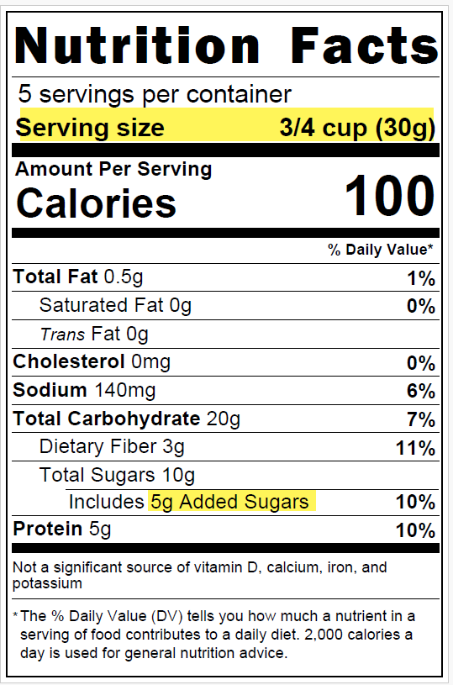
Table Method: Breakfast Cereals
Breakfast Cereal Added Sugars Limits
Serving Size | Added Sugars Limit
If the serving size is: | Added Sugars must not be more than:
0–2 grams | 0 grams
3–7 grams | 1 gram
8–11 grams | 2 grams
12–16 grams | 3 grams
17–21 grams | 4 grams
22–25 grams | 5 grams
26–30 grams | 6 grams
31–35 grams | 7 grams
Notes:
SHOW SLIDE: Table Method: Breakfast Cereal
SAY:
The next way for determining if a breakfast cereal meets the added sugars limit requirement is to use the table method. Very similar to determining yogurt products that meet the added sugars requirements, this method uses a table to determine the amounts of added sugars in breakfast cereal. It features pre-calculated added sugars limits for common serving sizes for breakfast cereals. In addition to finding this method on the Breakfast Cereal and Added Sugars Guide handout, you can also find it on the USDA Team Nutrition’s training worksheet “Choose Breakfast Cereals That Are Low in Added Sugar.” The link to this training worksheet is featured on the Training Resources handout in the Appendix of the Participant’s Workbook.
Take a 1–2 minutes to review the Breakfast Cereal and Added Sugars Guide handout.
DO:
Allow participants 1–2 minutes to review the handout, then review the steps with the participants. After you have completed this task, ask are there any questions before advancing to the next slide.

Slide 69
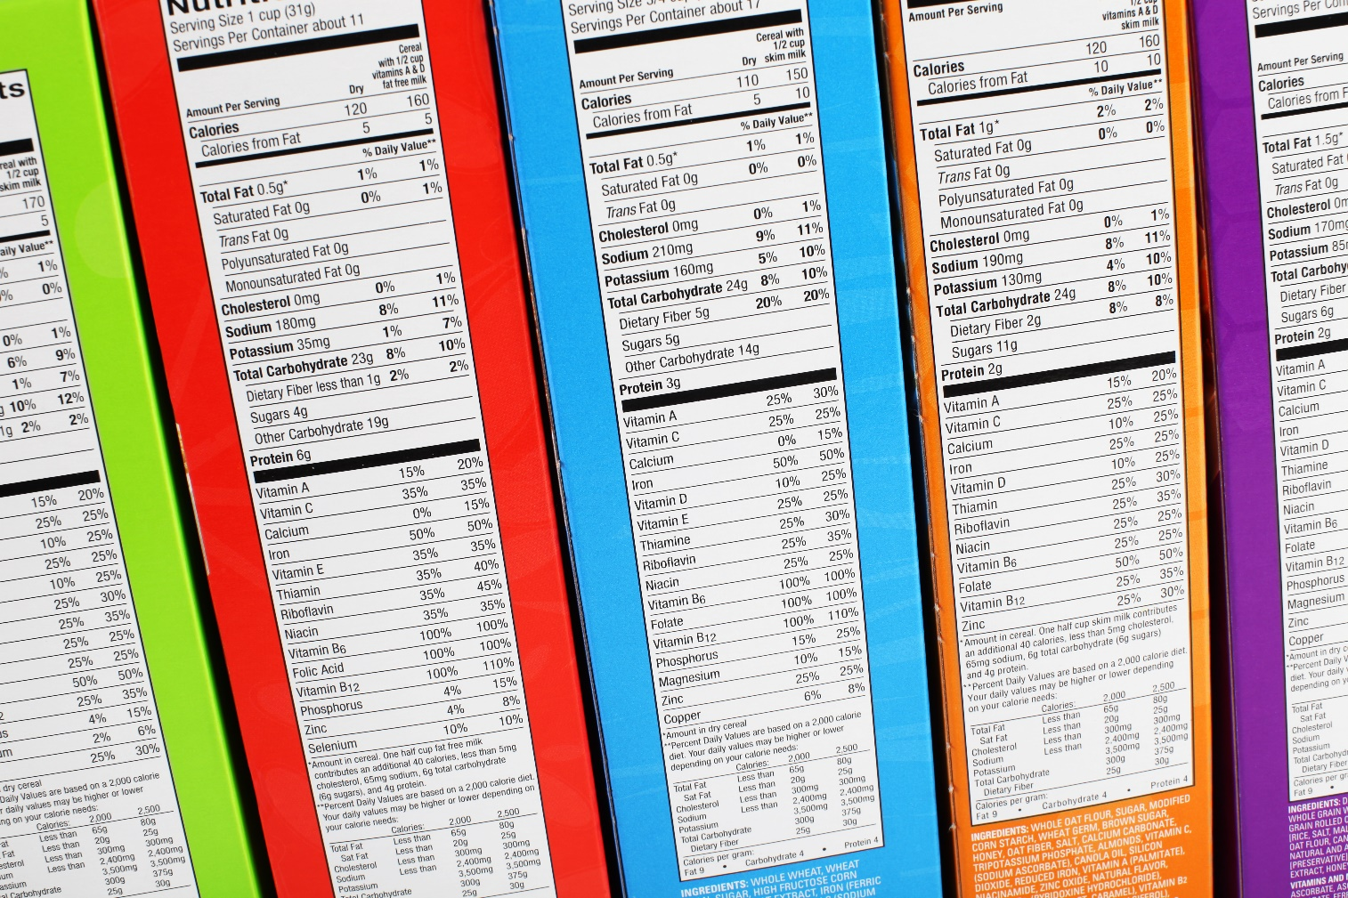
Activity: Breakfast Cereal–Is it Creditable
Notes:
SHOW SLIDE: Activity: Breakfast Cereal, Is it Creditable?
DO:(Workbook Activity): Breakfast Cereal, Is it Creditable?
Purpose: The purpose of this activity is to determine if each cereal meets the breakfast cereal guidelines for the CACFP meal pattern requirements.
Materials Needed: Breakfast Cereal, Is it Creditable? worksheet, and pen or pencil
Time: 10–15 minutes
Instructions:
SAY: Please turn to the Breakfast Cereal, Is it Creditable? worksheet in your Participant’s Workbook. Review each label and then, use the table method (added sugars limits table) to determine if the breakfast cereal contains no more than 6 grams of added sugars per dry ounce.
DO: Allow 5–10 minutes for the participants to complete the assignment. Then review the answers with the participants using the following answer key.

Slide 70

Deep-Fat Frying
May not be used to prepare meals on-site
  Includes central and satellite kitchens
Defined as food submerged in hot oil or other fat
May purchase from commercial manufacturer
  Pre-fried
  Flash-fried
  Par-fried
  Deep-fat fried
May not deep-fry when reheating
Notes:
SHOW SLIDE: Deep-Fat Frying
SAY:
The last update we will explore today is deep-fat frying, in which the food is cooked by submerging in hot oil or other fat. The updated meal pattern requirements no longer allow deep-fat frying as a way of cooking foods on-site or at central, satellite kitchens who prepare foods, and then deliver them to the site. This requirement applies to all CACFP age groups, including infants.
Foods that are pre-fried, flash-fried, par-fried, or deep-fat fried by a commercial manufacturer may be purchased and served as part of a reimbursable meal. Similarly, CACFP facilities that vend meals may claim vended meals that contain deep-fat fried foods as long as the food was prepared by the vendor off-site. These pre-fried items must be reheated by a method other than deep-fat frying.

Slide 71

Choose Healthier Methods
Deep-fat fried foods
  Strongly discouraged
  High in calories and solid fat
  Can negatively influence eating habits
  Increases the risk of chronic illnesses later in life
Consider the nutritional value of a food and how it contributes to healthy eating habits
Notes:
SHOW SLIDE: Choose Healthier Methods
SAY:
Serving infants any type of deep-fat fried food is strongly discouraged. These foods are often high in calories and solid fat, and eating too many fried foods can negatively influence eating habits and increase the risk of chronic illnesses later in life.
Therefore, it is a good practice to always consider the nutritional value of a food and how it contributes to the development of healthy eating habits when planning meals and snacks for infants. Likewise, serving infants nutritious foods as opposed to those high in fat, sugar, and calories, will help to establish the foundation for developing habits that can last a lifetime.
For some alternative ideas for cooking foods without deep-frying them, refer to the Cooking Methods handout in your Participant’s Workbook.

Slide 72

Activity: Recall that Term
Notes:
SHOW SLIDE: Activity: Recall that Term
DO: (Activity): Recall that Term
Purpose: The purpose of this activity is to identify the updated meal pattern requirements for infants.
Materials Needed: Term Cards
Time: 10–15 minutes
Instructions:
DO: Divide the class into groups of 4 participants. Distribute the Term Cards to each group.
SAY: Now that we have covered the guidelines for the updated infant meal pattern requirements, let’s play a game called Recall that Term. Each player will select a card, and it lists a term along with key requirements. When it is your turn, state the term on the card. Your teammates will then state the key requirement(s) for each term. For example, if my card lists breast milk, my teammate might say the best source of nutrients for infants. However, you cannot state the requirements or give any clues. If your teammates are unable to describe the term, you may pass to the next person. The first group to complete this activity wins the game.
DO: Allow each group 5–10 minutes to complete this activity. Then, review the following Answer Key: Recall that Term with the participants. The phrases are included in the following table. At the end of this activity, allow participants to return to their seats.
NOTE TO INSTRUCTOR: If this is a large group, consider completing this activity as a large group activity.

Slide 73
Training Review
Two age groups: Birth–5 months & 6–11 months
Encourages breastfeeding by allowing reimbursement for on-site feeding
Promotes developmental readiness
Provides more nutritious meals and snacks
Notes:
SHOW SLIDE: Training Review
SAY:
In this training, we covered the updated meal pattern requirements for infant meals and snacks. Specifically, we explored
the two age groups and how they promote breastfeeding by providing reimbursement when a mother breastfeeds her infant onsite,
key requirements for serving expressed milk and infant formula,
the importance of developmental readiness, and
how the updated requirements provide more nutritious foods for infants.
ASK:
At this time, are there any questions before we move to the last activity in this training?
DO:
Answer any questions and then, begin the next activity.
NOTE TO INSTRUCTOR: If there are questions that you are unable to answer, refer the participant(s) to their State agency or to the ICN Help Desk.

Slide 74

Activity: Key Points to Remember
Notes:
SHOW SLIDE: Activity: Key Points to Remember
DO:(Workbook Activity): Key Points to Remember
Purpose: The purpose of this activity is to reflect on the information covered in this training and to list any key points needed for later use.
Materials Needed: Key Points to Remember worksheet and pen or pencil
Time: 5 minutes
Instructions:
SAY: Turn to the Key Points to Remember worksheet in your Participant’s Workbook. Take a few minutes to think about the information covered in this training. List some key points you wish to remember for when you return to your facility.
DO: Allow about 2–3 minutes for participants to complete this activity and then, ask volunteers to share their responses. After everyone has finished, ask if there are any questions and then, begin the next training.
FEEDBACK: There are no right or wrong answers for this activity. However, some potential responses might include those noted in the following Answer Key: Key Points to Remember.

Slide 75
Post-Assessment
Notes:
SHOW SLIDE: Post-Assessment
DO: Post-Assessment
Purpose: The purpose of the Post-Assessment is to determine what the participants learned throughout the training.
Materials Needed: Post-Assessment, Training Evaluation, and pen or pencil
Time: 10 minutes
Instructions:
DO: Distribute the Post-Assessment and the Training Evaluation.
SAY: The Post-Assessment is designed to assess what you have learned during this training. Begin by placing the non-name identifier, used for your Pre-Assessment, at the top of the page. Then, complete the Post-Assessment by reading each question carefully and selecting the best answer. Upon completion, please complete the training evaluation.
DO: Allow a minimum of 10 minutes for participants to complete the Post-Assessment. Remind them to list the identifier they used on the Pre-Assessment. Collect the Post-Assessments and the training evaluation. Then, dismiss the training.

Slide 76

Thank You!
Institute of Child Nutrition
Telephone: (800) 321-3054
E-Mail: helpdesk@theicn.org
Website: https://theicn.org/icn-resources-a-z/infant-meal-pattern-requirements-trainings/

Slide 77




www.theicn.org 800-321-3054
Email: helpdesk@theicn.org
Follow ICN on Social Media!
facebook.com/ichildnutrition
@ichildnutrition
instagram.com/theicn
linkedin.com/company/theicn

