Slide 1
Customer Experience, Merchandising, and Food Presentation

Slide 2
Lesson Objectives
Identify the customer.
State how the principles of customer service, merchandising, and food presentation relate to attracting and keeping customers.
Demonstrate how to use menus as part of a merchandising effort to attract customers and influence the preferences of children.
Develop a method for evaluating customer service.

Slide 3
Identify Your Customer
Who are the primary customers?
Who are the secondary customers?
What influences the needs and wants of the school nutrition customers?
What factors or groups influence customers' eating habits?

Slide 4
Customer Experience Scenarios
Scenarios
First Grade Student
Second Grade Student
Fourth Grade Student
Seventh Grade Student
High School Student Breakup
High School Boy

Slide 5
“What Students Say” and “What Students Hear”
What Students Say:
“Is that green stuff Broccoli?”
“Lunch was great today.”
What Students Hear:
“Come on and get moving!”
“Have a great day.”

Slide 6
Statements Customers Hear When They Enter a Restaurant
“Hi, may I help you?”
“Great to see you today; hope you enjoy your meal.”
“Great choice of food selections today.”
“Don’t you look nice today?”

Slide 7
Bullying
Have you witnessed bullying in your school programs?
What should you do if you witness bullying in your operation?

Slide 8
Needs and Wants
List two needs.
List two wants.

Slide 9
Principles of Customer Service, Merchandising, and Food Presentation and Quality Meal Service
First impressions
Key elements
Terms
Food quality standards

Slide 10
5 Key Elements of Presentation
COLOR
Shape
Texture
Height
Simplicity

Slide 11
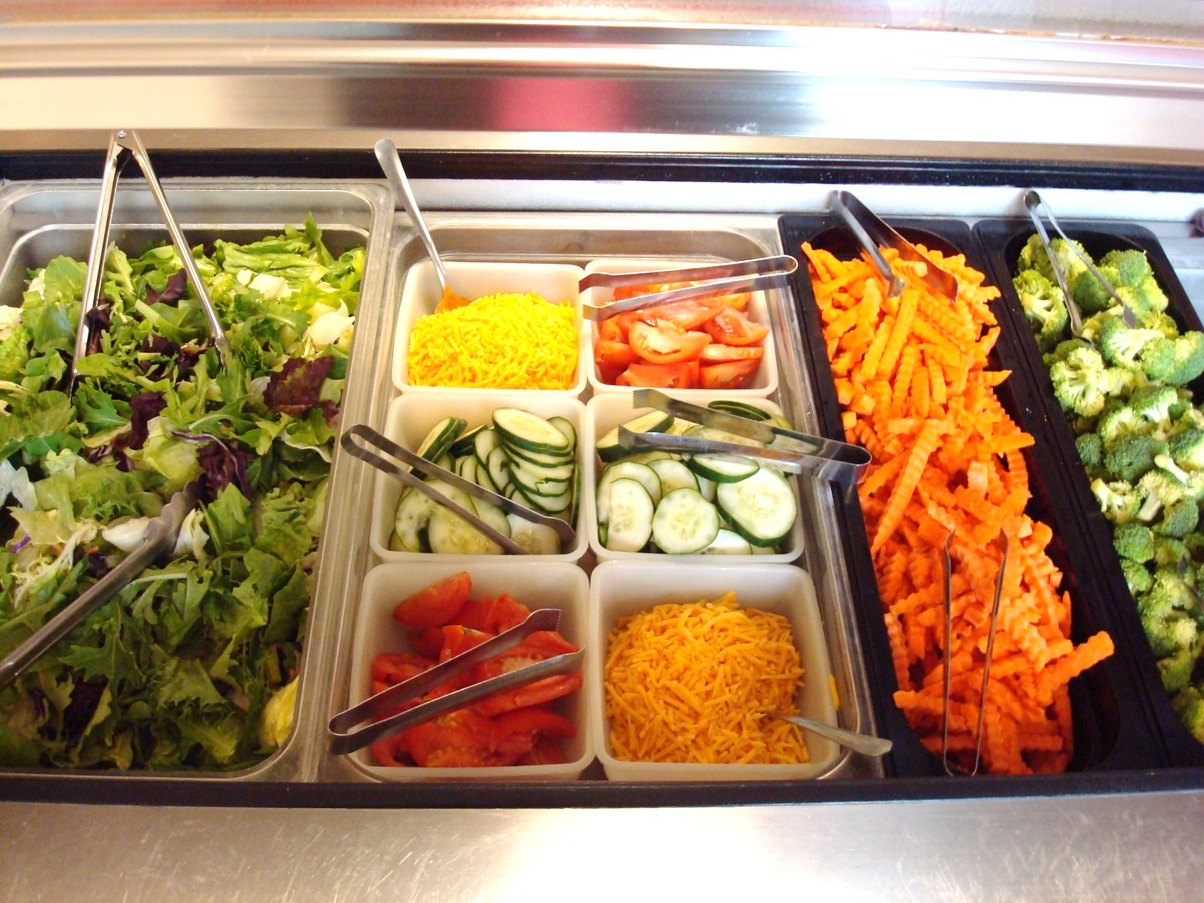
Colorful Serving Line 1

Slide 12
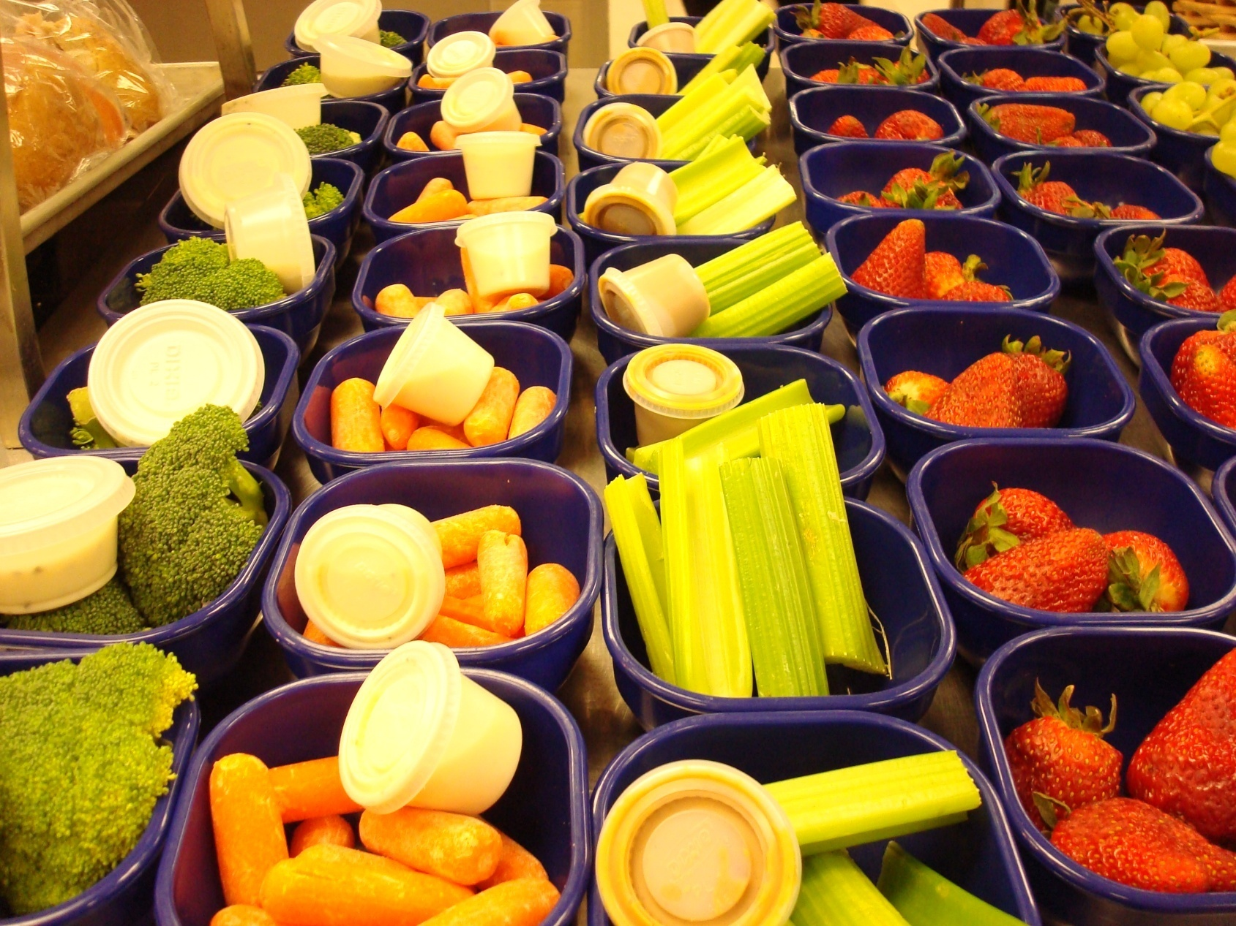
Colorful Serving Line 2

Slide 13
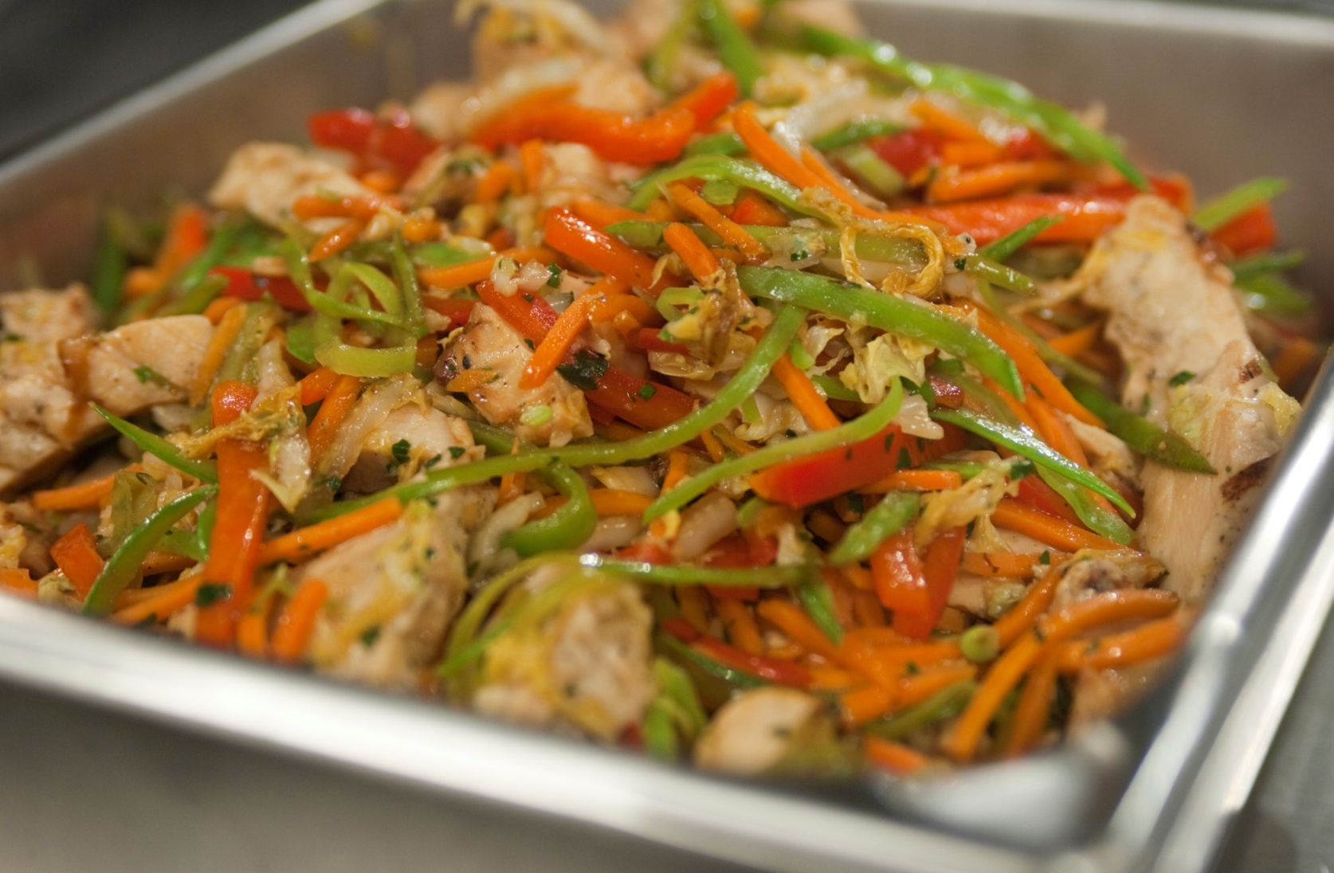
Colorful Serving Line 3

Slide 14
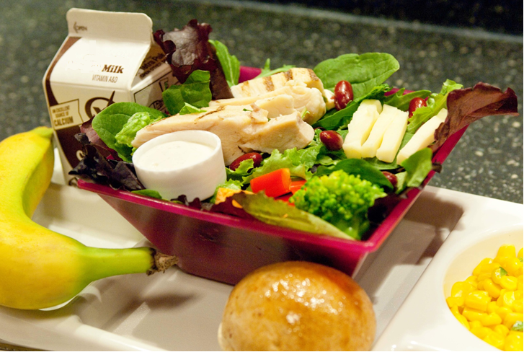
Color

Slide 15
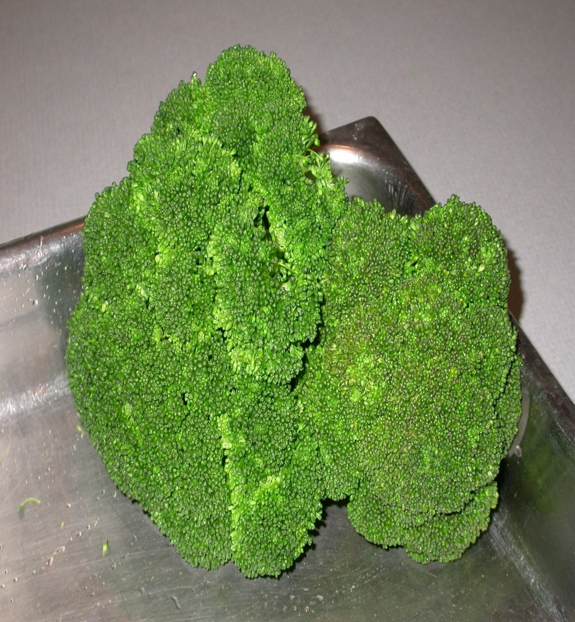
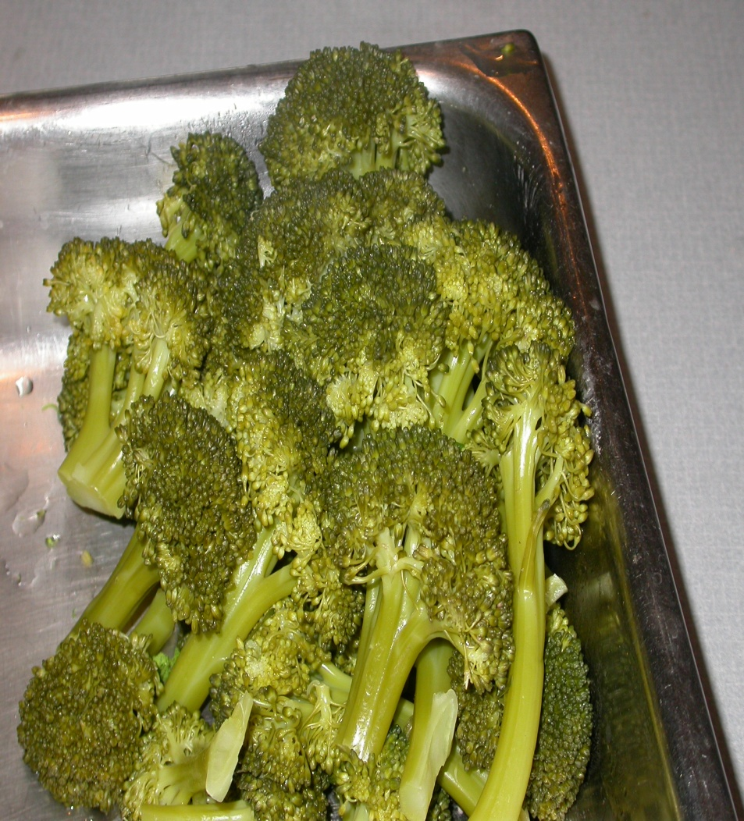
Color: Preparation Techniques

Slide 16
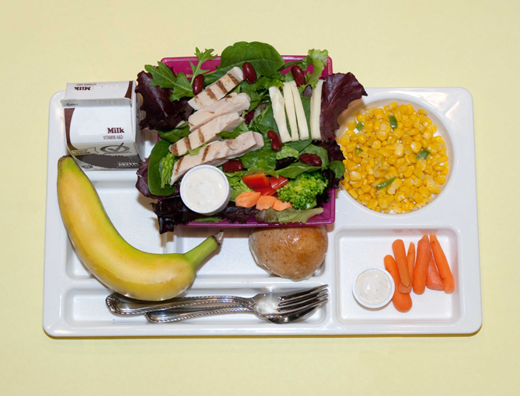
Texture

Slide 17
Texture Names
Grilled Chicken Strips
Crisp Mixed Greens
Hearty Red Kidney Beans
Creamy Dressing
Crunchy Baby Carrots
Tender Corn
Ripe Green Tip Banana
Crusty Whole Wheat Roll

Slide 18
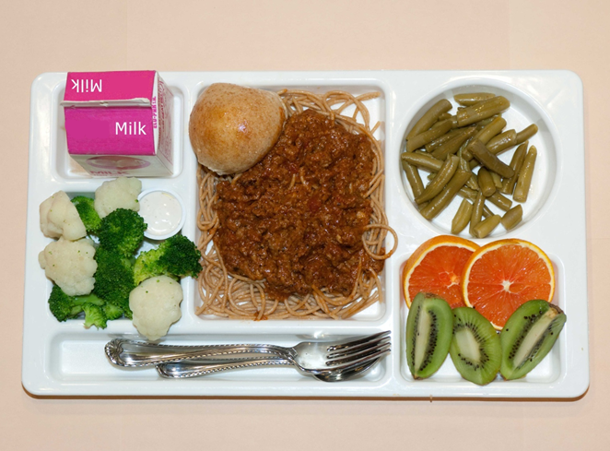
Shapes: Food Variety 1

Slide 19
Shapes: Food Variety 2
How many ways can you cut a sandwich?

Slide 20
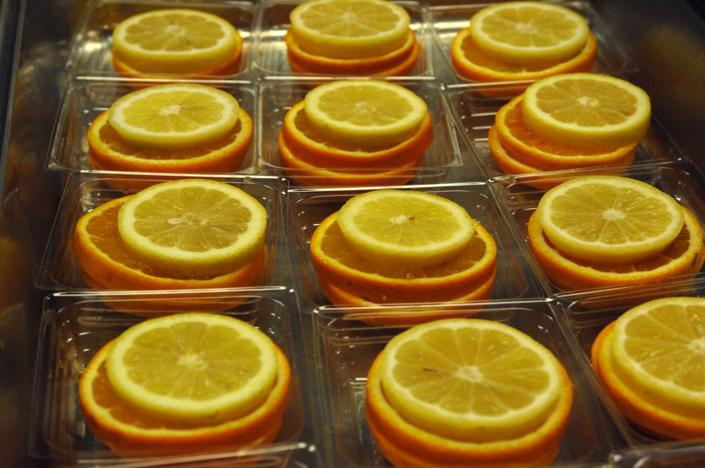
Shapes: Food Variety 3

Slide 21
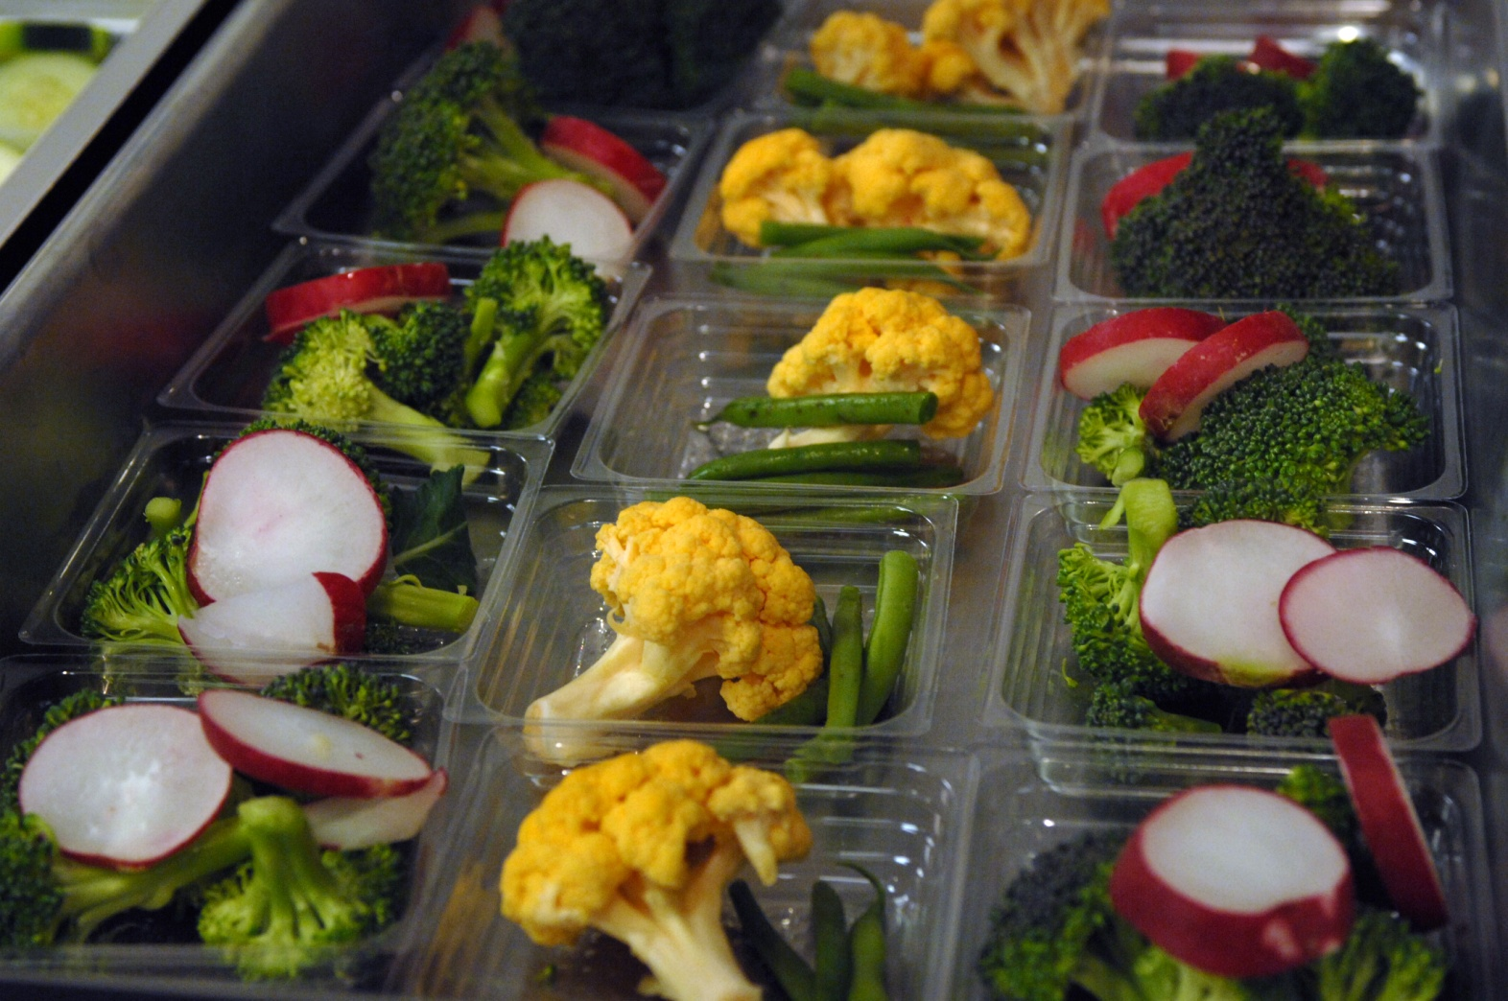
Shapes: Food Variety 4

Slide 22
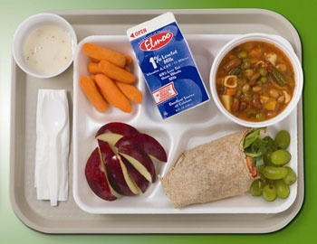
Simplicity

Slide 23
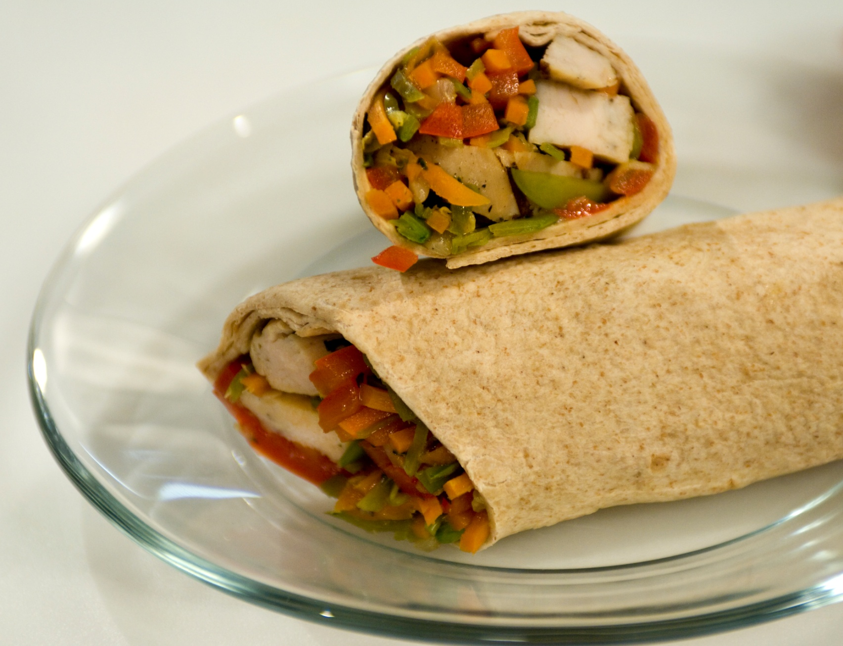
Height

Slide 24
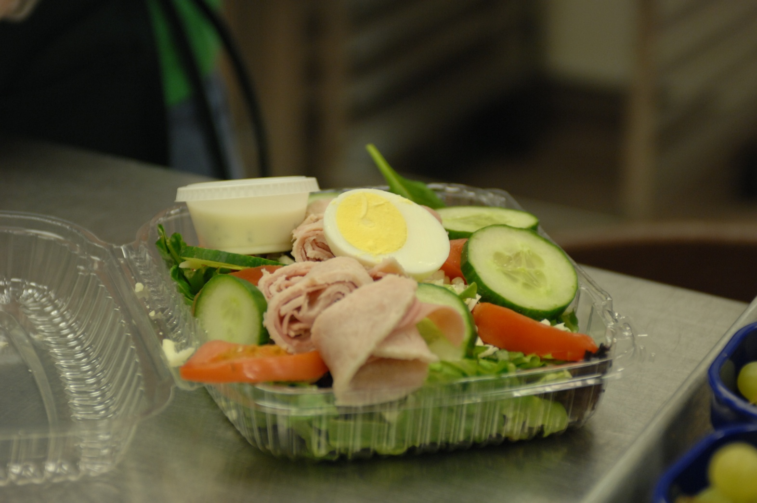
Self-Serve Packaging

Slide 25
Service Line Checklist
Design a short audit tool for our everyday service line.

Slide 26
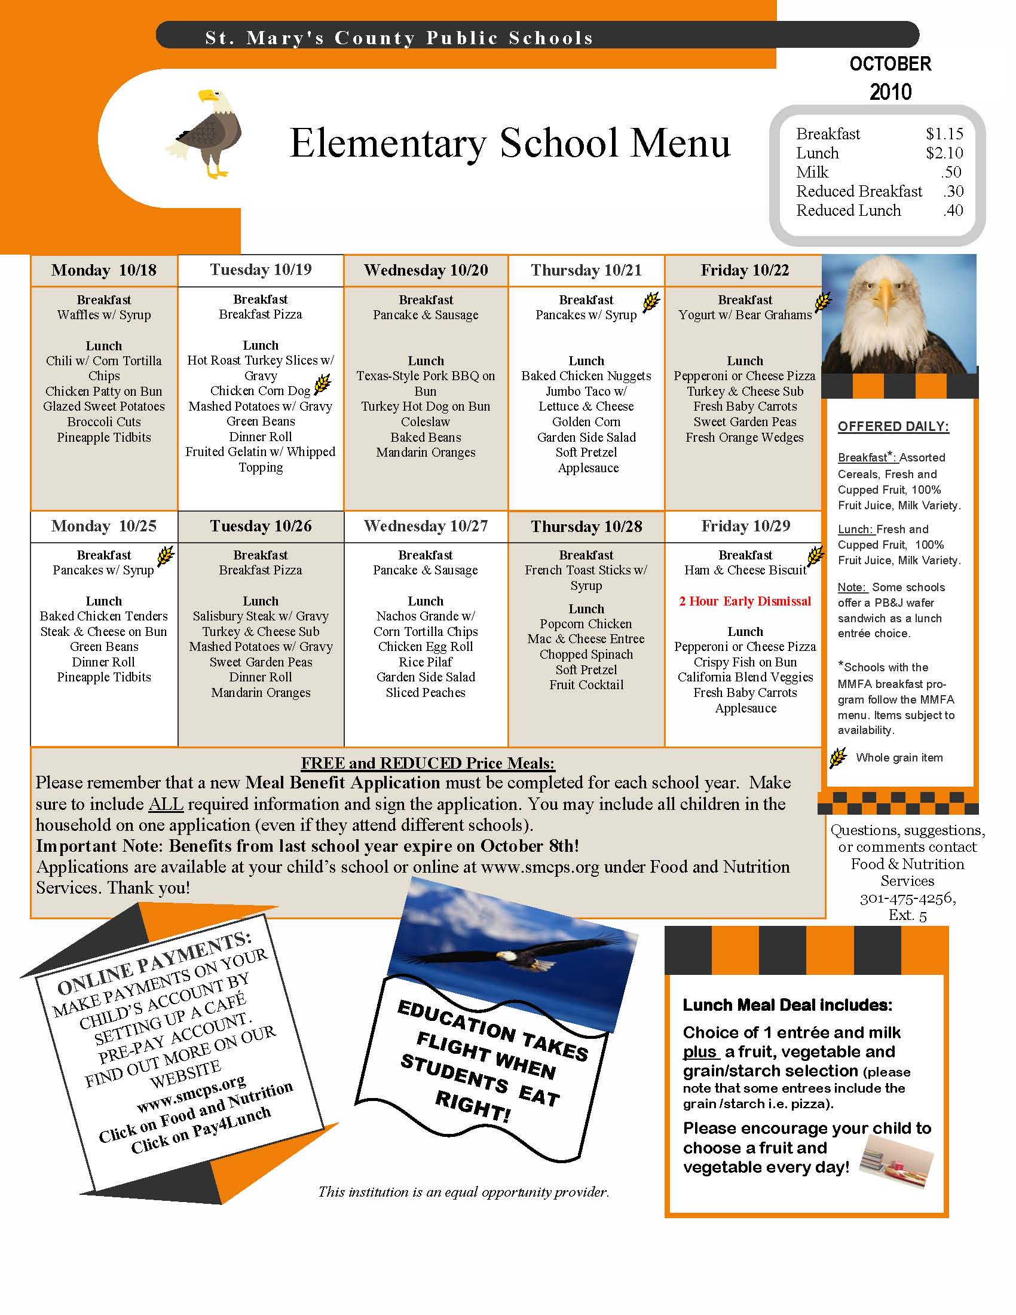

Slide 27
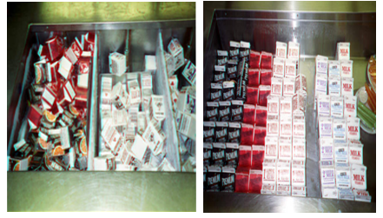
Serving Lines: Look Appealing

Slide 28
Why Do We Evaluate Customer Service?
To know what our customers think of our service
To gain ideas and suggestions for improvement
To identify problems and solutions for solving problems

Slide 29
How Do We Evaluate Customer Service?
Focus on the Customer has some suggestions:
  Ask your customer and listen to answers
  Keep asking your customer for feedback
  Observe customer behavior and choices
  Survey customers using age appropriate methods
  Talk to customers

Slide 30
Customer Feedback
Identify five characteristics or tools that would help them get to know customers’ likes and dislikes.

Slide 31
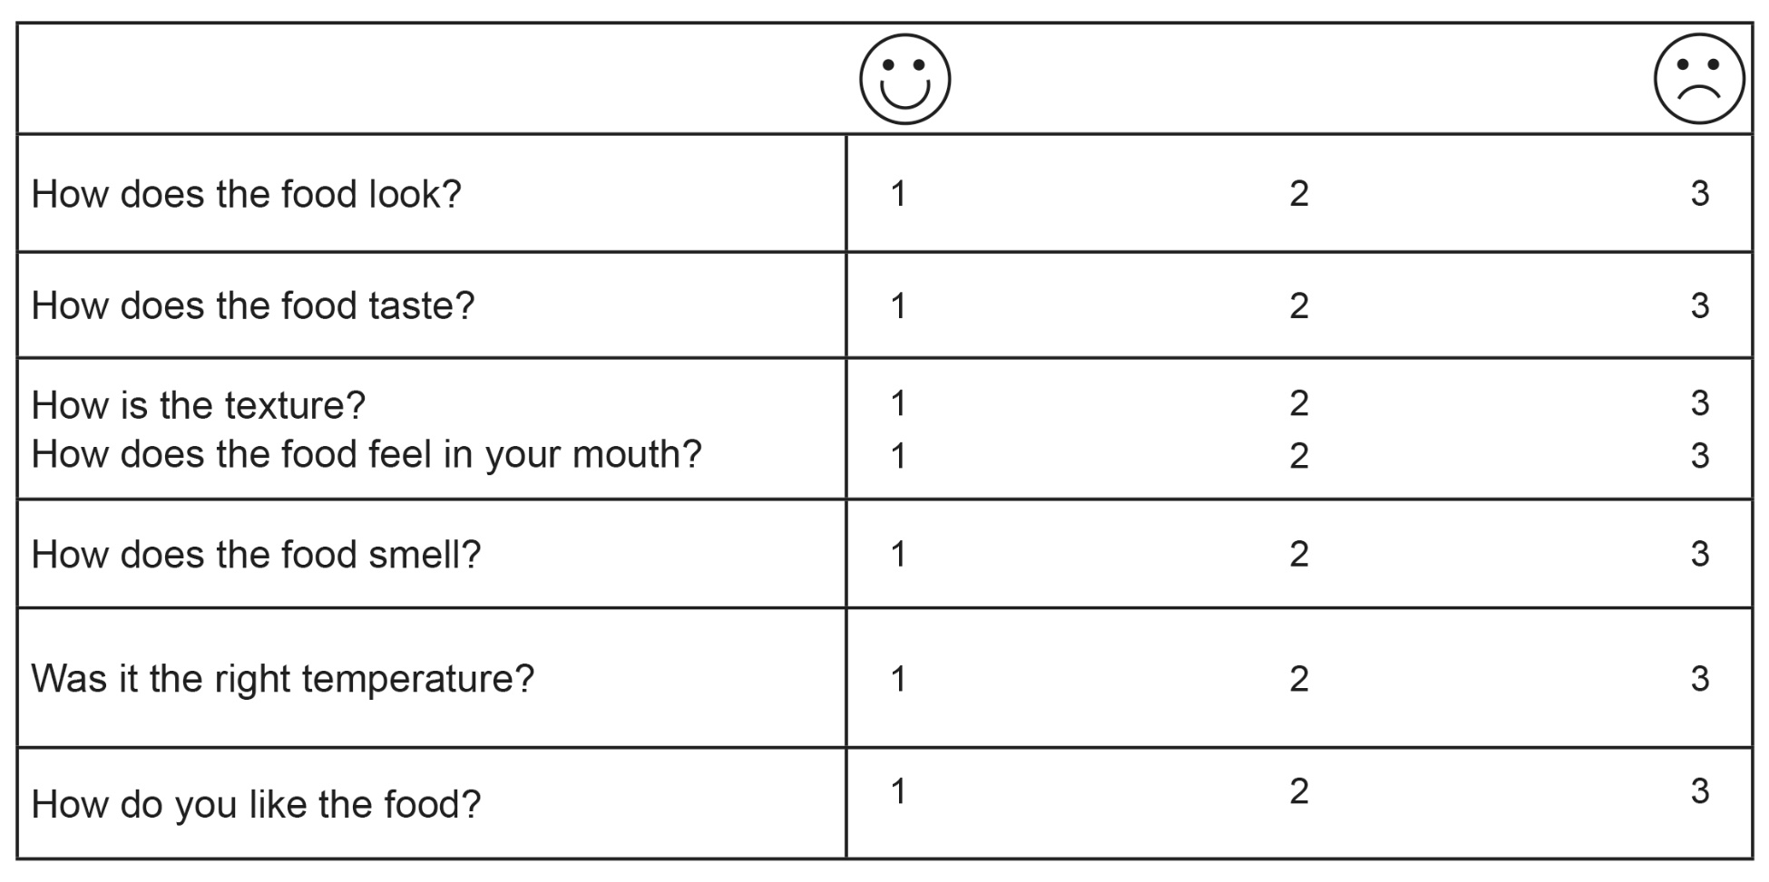
Sample Taste Test Form

Slide 32
Quality Foodservice Survey
(Self-Assessment)
Self-assessment is as important as the evaluations that other people do.

Slide 33
Conclusion
SMART Goals

