Slide 1
Major Food Allergens
CACFP iTrain
Simple Lesson Plan

Slide 2
Introduction
Trainer and Participants’
Introductions

Slide 3
Welcome!

Slide 4
Review Current Knowledge
Do you have any children in your CACFP center with food allergies? What foods are they allergic to?

Slide 5
Overview
Notes:
Food allergies can be life threatening. Avoiding allergens keeps children safe. The purpose of this training is to discuss the nine most common allergens for children and to raise the CACFP staff’s awareness of uncommon food sources of allergens. The training will address key information for limiting the risk of an allergic reaction due to a food allergy.

Slide 6
Lesson Objective
Identify the nine common allergens.

Slide 7
Common Food Allergens
Milk
Eggs
Wheat
Peanuts
Tree nuts
Soy
Fish
Shellfish
Sesame
Notes:
Ask posing question: What are common food allergens?
Share core content: Food allergies can happen from any food, but nine main foods cause the majority of problems for children. The major allergens are milk, eggs, wheat, peanuts, tree nuts, soy, fish, shellfish, and sesame. The food allergen could be a small amount left on a cutting board or a spoon. Start meal preparation and service with clean utensils.

Slide 8
Reading Ingredient Statements
Check every label, every time you purchase and prepare food
Allergens found in many foods
Manufacturers required to list ingredients and presence of the nine major food allergens on the label
With the exception of sesame which is not required to be listed until January 2023
Notes:
Share core content: People with food allergies have to make wise food choices through careful label reading. As a child care professional, check every label, every time you purchase and prepare the food for children with food allergies. Allergens are found in many foods. Manufacturers are required to list the ingredients and the presence of the eight major food allergens on the label.
Note: The FASTER Act expands what is considered a major allergen that has to be declared on a food label from eight to nine by adding sesame as a major allergen. This law will take effect in January 2023, but manufacturers may begin incorporating sesame as a major allergen on their food label before this date. Contact the food manufacturer if there is any uncertainty about a food containing sesame.

Slide 9
Milk
Milk allergens come from the protein in whole, 2%, 1%, and skim, cream, yogurt, cheese, ice cream
Less obvious milk ingredients:
Casein
Ghee
Butter
Curds
Lactose
whey
Notes:
Share core content: Milk allergens come from the protein in whole milk, 2% milk, 1% milk, skim milk, cream, yogurt, cheese, or ice cream. These items are obvious milk-containing foods. Other less obvious milk ingredients are casein, ghee, butter, curds, lactose, or whey.

Slide 10
Eggs
Both the whites and yolks can be an allergen.
Some common names on food labels:
Albumin (also spelled albumen)
Egg (dried, powdered, solids, white, and yolk)
Eggnog
Lysozyme
Mayonnaise
Meringue (meringue powder)
Ovalbumin
Surimi
Notes:
Share core content: Eggs, both the whites and yolks, can be an allergen. Eggs frequently are used as an ingredient. Some common names on food labels are albumin (also spelled albumen), egg (dried, powdered, solids, white, and yolk), eggnog, lysozyme, mayonnaise, meringue (meringue powder), ovalbumin, or surimi. Check labels carefully!

Slide 11
Wheat
Wheat sources include bread, rolls, pastry, cookies, cake, and cereal made with wheat. Whole grain and refined wheat both cause allergic reactions.
Some unexpected sources of wheat are processed meats, rice cakes, salad dressings, sauces, and soups.
Notes:
Share core content: Wheat sources include bread, rolls, pastry, cookies, cake, and cereal made with wheat. Whole grain and refined wheat both cause allergic reactions. Avoid foods that contain wheat or any of these ingredients: bread crumbs, bulgur, couscous, flour (all-purpose, bread, cake, durum, enriched, graham, high-gluten, high-protein, instant, pastry, self-rising, soft wheat, steel ground, stone ground, whole wheat), pasta, wheat (bran, durum, germ, gluten, grass, malt, sprouts, starch).
Some unexpected sources of wheat are processed meats, rice cakes, salad dressings, sauces, and soups. As a reminder, grain-based desserts are not reimbursable in the CACFP.

Slide 12
Peanuts
Stand alone as a major allergen
Avoid foods that contain peanuts or any of peanut by-products
Notes:
Peanuts stand alone as a major allergen. Avoid foods that contain peanuts or any of these ingredients: Arachis oil (another name for peanut oil), artificial nuts, beer nuts, cold-pressed, expelled or extruded peanut oil, goobers, ground nuts, mixed nuts, nut meat, nut pieces, peanut butter, peanut flour, and peanut protein hydrolysate.

Slide 13
Tree Nuts
Pine nuts
Chestnuts
Hazelnuts
Brazil nuts
Walnuts
Almonds
Cashews
Pistachios
Pecans
Notes:
Share core content: Another allergen is tree nuts, which include pine nuts, chestnuts, hazelnuts, Brazil nuts, walnuts, almonds, cashews, pistachios, and pecans. Avoid foods that contain tree nuts or any of these ingredients: artificial nuts, natural nut extract, nut butters (e.g., cashew butter), nut distillates/alcoholic extracts, nut meal, nut meat, nut milk (e.g., almond milk, cashew milk), nut oils (e.g., walnut oil, almond oil, nut paste (e.g., almond paste), or nut pieces.

Slide 14
Soy
Soy is added to many foods as a way to add protein or enhance flavor.
Notes:
Soy is added to many foods as a way to add protein or enhance flavor.

Slide 15
Fish
Fish from both fresh water and the sea cause allergic reactions in some children.
Avoid fish oil and fish sticks
Some unexpected sources of fish:
Barbecue sauce
Caesar dressing
Imitation/artificial fish or shellfish (e.g., Surimi, also known as “sea legs” or “sea sticks”)
Worcestershire sauce
Notes:
Share core content: Fish from both fresh water and the sea cause allergic reactions in some children. Catfish, codfish, and tuna fish equally create problems. Also, avoid these fish products: fish oil and fish sticks. Some unexpected sources of fish are barbecue sauce, caesar dressing, imitation or artificial fish or shellfish (e.g., surimi, also known as “sea legs” or “sea sticks”), or Worcestershire sauce.

Slide 16
Shellfish
Separated from fish as an allergy group
Some children can eat fish but not shellfish
Avoid foods that contain shellfish or any of these ingredients:
Barnacle
Crab
Crawfish (crawdad, crayfish, and écrevisse)
Krill
Lobster (langouste, langoustine, moreton bay bugs, scampi, and tomalley)
Prawns
Shrimp (crevette, scampi)
Notes:
Share core content: Shellfish are separated from fish as an allergy group. Some children can eat fish but not shellfish. Avoid foods that contain shellfish or any of these ingredients on the label: barnacle, crab, crawfish (crawdad, crayfish, and écrevisse), krill, lobster (langouste, langoustine, Moreton bay bugs, scampi, and tomalley), prawns, or shrimp (crevette, scampi.)

Slide 17
Sesame
Usually found in foods in the form of seeds or oil
A protein found in sesame causes an allergic reaction
Notes:
Share core content: Sesame is usually found in foods in the form of seeds or oil. A protein found in sesame is what causes an allergic reaction.
In 2021, the Food Allergy Safety, Treatment, Education, and Research Act (FASTER) was passed into law. This act expands what is considered a major allergen that has to be declared on a food label from eight to nine by adding sesame as a major allergen. This law will take effect in January 2023, but manufacturers may begin incorporating sesame as a major allergen on their food label before this date. Contact the food manufacturer if there is any uncertainty about a food containing sesame.

Slide 18
Activity
Nine Common Allergens
Notes:
Activity: Nine Common Allergens Time: 10 minutes
Purpose: List and describe the foods that cause the most food allergies in children.
Materials Needed: Top Nine Foods That Cause Allergies handout
Instructions: Using the Top Nine Foods That Cause Allergies handout, identify foods you serve at your child care center that contain some of the major allergens. Go around the group and ask for one allergen and one allergen food served at their child care center. Go back over the major allergens and at the bottom of the page, write a food you serve that would be a combination of several allergens. For example, pizza contains milk, wheat, and sometimes soy.

Slide 19
Conclusion

Slide 20
Lesson Conclusion
Nine major allergens create the majority of allergic reactions in children.
milk, eggs, wheat, peanuts, tree nuts, soy, fish, shellfish, and sesame
Several allergens can be found in the same menu item.
Read labels carefully for allergens every time you purchase and prepare the food!
Allergic reactions can be created with a large amount or a very small amount of the allergen.
Remember that while this training only covers the nine major allergens, other foods can cause allergic reactions in children.
Notes:
Nine major allergens create the majority of allergic reactions in children. The allergens are milk, eggs, wheat, peanuts, tree nuts, soy, fish, shellfish, and sesame. Several allergens can be found in the same menu item. Read labels carefully for allergens every time you purchase and prepare the food! Allergic reactions can be created with a large amount or a very small amount of the allergen. Remember that while this training only covers the nine major allergens, other foods can cause allergic reactions in children.

Slide 21
Activity
Speed Action Planning

Slide 22
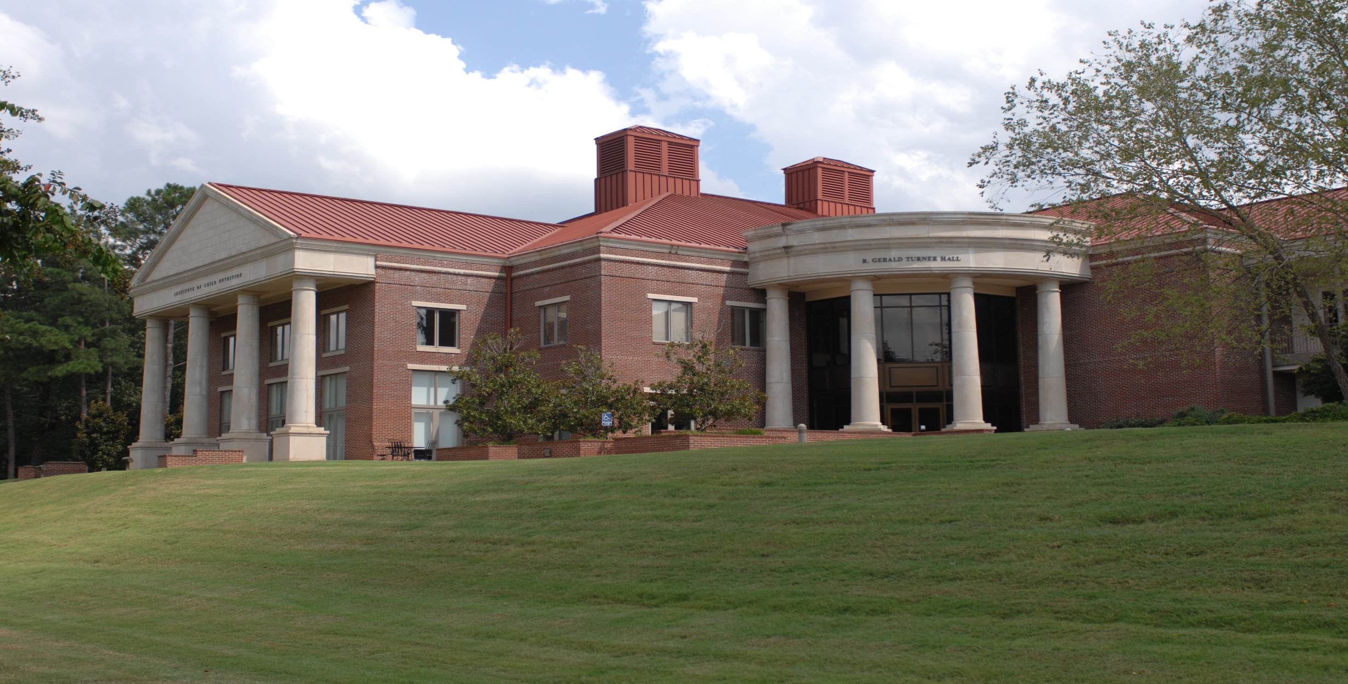
The University of Mississippi School of Applied Sciences www.theicn.org  800-321-3054 helpdesk@theicn.org
Thank You!
Follow ICN on Social Media!
facebook.com/ichildnutrition
@ichildnutrition
instagram.com/theicn
pinterest.com/theicn

