Slide 1
Keep Food Safe: Control Food Temperature
CACFP iTrain
Simple Lesson Plan

Slide 2
Introduction
Trainer and Participants’
Introductions

Slide 3
Welcome!

Slide 4
Temperature Danger Zone
Within how many hours should food sitting at room temperature be cooled to prevent bacteria growth?

Slide 5
Overview

Slide 6
Lesson Objective
Define the temperature danger zone.

Slide 7
Temperature Danger Zone
The temperature danger zone is the temperature range of 40 °F – 140 °F in which bacteria grow rapidly.

Slide 8
Flow of Food
Buying
Delivering
Storing
Preparing

Slide 9
Buying Groceries
Take coolers and ice packs
Clean and organize refrigerators before receiving groceries
Check refrigerator temperature (38 °F) when putting food away – freezers should be 0 °F

Slide 10
Cooking
Only take foods out of the refrigerator as needed when preparing for a meal
Cook food to the appropriate internal temperature
Always check and record the food temperature during and at the end of cooking

Slide 11
Holding and Serving
Keep hot food at 140 °F or above
Keep cold food at 40 °F or less

Slide 12
Cooling and Reheating
Bacterial growth is the greatest when cooling foods due to the temperature drop
Be sure to cool foods as quickly as possible
Reheat leftover foods to 165 °F within two hours
Food should not be in the danger zone for more than 4 hours

Slide 13
Activity
Temperature Danger Zone: “Keep Foods Out”

Slide 14
Conclusion

Slide 15
Lesson Conclusion
Keeping foods below 40 °F or above 140 °F slows the growth of bacteria.
Throughout every step of handling food, keep food temperatures out of the temperature danger zone.

Slide 16
Activity
Speed Action Planning

Slide 17
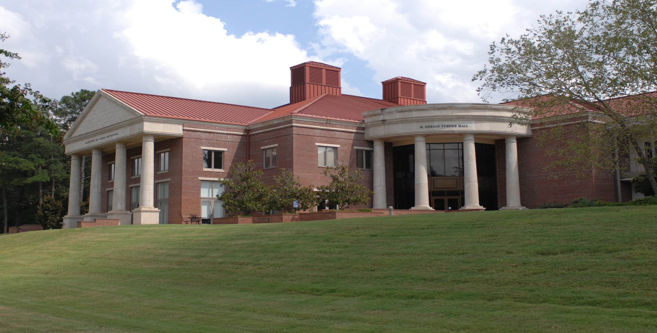
The University of Mississippi School of Applied Sciences www.theicn.org  800-321-3054 helpdesk@theicn.org
Thank You!
Follow ICN on Social Media!
facebook.com/ichildnutrition
@ichildnutrition
instagram.com/theicn
pinterest.com/theicn

