Slide 1

Keep Food Safe: Clean, Sanitize, and Disinfect
CACFP iTrain
Simple Lesson Plan

Slide 2
Introduction
Trainer and Participants’
Introductions

Slide 3
Welcome!

Slide 4
Review Current Knowledge
What are some things that you should clean and sanitize in child care facilities?
Notes:
Feedback: Possible answers: Food contact surfaces, sinks, equipment, toys, tables

Slide 5
Overview
Notes:
Share core content: Properly cleaning and sanitizing reduces the opportunity for bacteria and viruses to contaminate food. Careful cleaning and sanitizing kitchen tools and work surfaces will reduce germs and help prevent foodborne illness in your kitchen.

Slide 6
Lesson Objective
Demonstrate cleaning, rinsing, and sanitizing good practices to prevent contamination of food.

Slide 7
Cleaning and Sanitizing
Reduces the opportunity for bacteria and viruses to contaminate food.
Surfaces: any food contact surfaces, sinks, equipment, toys, and tables.
Notes:
Ask posing question: What are the key steps in making sure a food contact surface is clean and sanitary?
Share core content: Proper cleaning and sanitizing reduces the opportunity for bacteria and viruses to contaminate food. Some of the important surfaces to clean and sanitize are any food contact surfaces, sinks, equipment, toys, and tables. Sanitizing toys and equipment stop cross-contamination.

Slide 8
Maintaining Safe Environments
Proper cleaning and sanitizing reduces risk of cross-contamination
  Cross-contamination-transfer of bacteria or viruses from one surface to another.
Notes:
Share core content: Cleaning and sanitizing are important for maintaining safe environments in child care settings. Child care employees who follow proper cleaning and sanitizing practices reduce the risk of cross-contamination that can lead to foodborne illnesses. Cross-contamination is defined as the transfer of bacteria or viruses from one surface to another.

Slide 9
Wash, Rinse, and Sanitize
  Before each use
  Between uses when preparing different types of raw animal foods such as eggs, fish, meat, and poultry
  Between uses when preparing ready-to-eat foods and raw animal foods such as eggs, fish, meat, and poultry
  Any time contamination occurs or is suspected
  Before preparing an allergen-free meal
Notes:
Share core content: Wash, rinse, and sanitize food contact surfaces on sinks, tables, equipment, utensils, thermometers, and carts.
Before each use
Between uses when preparing different types of raw animal foods such as eggs, fish, meat, and poultry
Between uses when preparing ready-to-eat foods and raw animal foods such as eggs, fish, meat, and poultry
Any time contamination occurs or is suspected
Before preparing an allergen-free meal

Slide 10
How to Wash, Rinse, and Sanitize
Wash the surface with a detergent solution to clean.
Rinse the surface with clean water to remove debris and detergent.
Sanitize the surface using a sanitizing solution mixed at the concentration specified on the manufacturer’s label to kill microorganisms.
Allow the surface to air dry to prevent recontamination.
Notes:
Share core content:
Wash, rinse, and sanitize food contact surfaces by washing the surface with a detergent solution to clean.
Rinse the surface with clean water to remove debris and detergent.
Sanitize the surface using a sanitizing solution mixed at the concentration specified on the manufacturer’s label to kill microorganisms.
Allow the surface to air dry to prevent recontamination.
Refer to the manufacturer’s instructions on how to use the chemical—particularly sanitizers. If you use too little chemical, you will not kill the germs. If you use too much chemical, it can become a poison. Clearly label all chemicals and do not store them with food.

Slide 11
Activity
Contamination Charlie
Notes:
Activity: Contamination Charlie
Time: 10 minutes
Purpose: The purpose of the activity is to assess a kitchen for cleaning, rinsing, and sanitizing food contact surfaces. Procedures, chemicals, and equipment used in the kitchen should be evaluated to follow best practices.
Materials Needed: Contamination Charlie handout and Pen/Pencil
Instructions: Distribute the Contamination Charlie handout. Have participants read the case study, and then turn to a partner and list ideas to prevent the situation. Also, ask them to review the Cleaning and Sanitizing fact sheet for ways Charlie could do a better job. Allow 5 minutes for participants to review the case study and discuss ideas with a partner. Ask each group to describe one problem and one “best practice recommendation” to prevent the problems created by Charlie.

Slide 12
Conclusion

Slide 13
Lesson Conclusion
Careful cleaning and sanitizing help keep the child care environment safe.
Food contact surfaces need to be washed, rinsed, and sanitized to prevent the contamination of food and cross-contamination with other surfaces in the child care center.
Notes:
Careful cleaning and sanitizing help keep the child care environment safe. Food contact surfaces need to be washed, rinsed, and sanitized to prevent the contamination of food and cross-contamination with other surfaces in the child care center. Using the right chemicals in the right concentration, keeps surfaces clean and sanitized.

Slide 14
Activity
Speed Action Planning

Slide 15

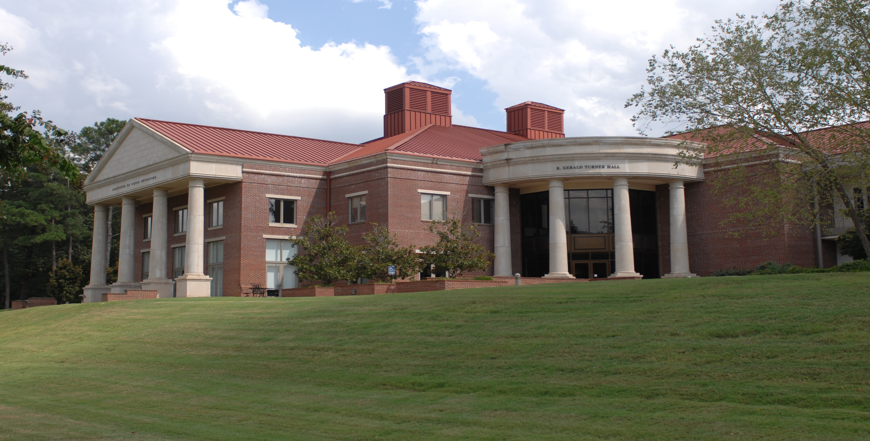



The University of Mississippi
School of Applied Sciences www.theicn.org  800-321-3054 helpdesk@theicn.org
Thank You!
Follow ICN on Social Media!
facebook.com/ichildnutrition
@ichildnutrition
instagram.com/theicn
pinterest.com/theicn

